Slide 1

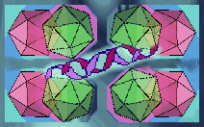
Case Based Approach:
Spectrum of ABMR
Prof Parmjeet Randhawa, M.D.,
Division of Transplantation
Department of Pathology
University of Pittsburgh
Notes:
Moderator
Sunset
SATURDAY Feb 18th: 2: 20 to 3:00. Await instructions about how much time to build in for questions ( 5 vs 10)
SATURDAY
Feb 18th: 2: 20 to 3:00 = 40 MINUTES. Await instructions about how much time to build in for questions ( 5 vs 10). Timing is best checked in PPT slide show presenter mode
INTRODUCTION 11 mins; try to practice shorter versions of basic ABMR criteria slides
Case 1 is 2min. Case 2 is 5 mins and its follow up biopsy is 11 mins; case 3 is 4 mins by skipping the technical c4d/DSA slides
Case 4 : is 6mins at least cover the criteria for chronic INACTIVE ABMR (very likely there will be no time for new onset CV)
--your laptop has large screen—BUT I think PPT presentation mode windows are customizable---practice and get -RELIABLE ACCESS TO YOUR NOTES---better than trying to arrange to directly project from my laptop---
Confirm: slide show---and the size of the presenter view text box—ON YOUR PERSONAL DESKTOP---remember this box can be expanded right there both laterally and vertically-PRINT PROBLEM OR WORTH REVIEWING SLIDES

Slide 2
DISCLOSURES
Consultancy: Allovir Inc. (Viralym-M trial)
Editorial Board: Clinical Transplantation
Board of Directors, Renal Pathology Society
Notes:
These are my disclosures, none of which are relevant for today’s talk

Slide 3
Antibody Mediated Rejection—
Histologic evidence of tissue injury
Microvascular inflammation peritubular capillaritis or glomerulitis
Thrombotic microangiopathy or unexplained ATN
Evidence of Antibody Interaction with the Endothelium
Microvascular inflammation (g+ptc>1 in the absence of TCMR/BL/GN/BKVN
OR
C4d staining in peritubular capillaries (> 1 FS, >0 FFPE)
Serologic Evidence
HLA or non-HLA DSA or ABO antibodies
Notes:
As a prelude to discussing individual cases, it will be appropriate to review the Banff Criteria for the diagnosis of ABMR
FIRST It requires Histologic evidence of tissue injury which may be in the form of
Microvascular inflammation peritubular capillaritis or glomerulitis
Thrombotic microangiopathy or unexplained ATN
SECOND There has to be evidence of antibody interaction with the endothelium
This criterion can be satisfied by a Microvascular g+ptc score of >1 in the absence of TCMR/BL/GN/BKVN, in which case ptc alone cannot be used to diagnose ABMR. There must be glomerulitis to go along with it
Alternately, you can show C4d staining in peritubular capillaries ( the score must be > 1in FS, but can be any score >0 in the case of FFPE)
Finally, we need serologic evidence.
This can mean the presence of HLA or non-HLA DSA or ABO antibodies
xxxxxxxxxxxxxxxxxxxxxxxxxxxxxxxxxxxxx
2001 view point; All 3 required; 2 are suspicious; 2013 allowed C4d negative & enabled substitution of DSA by g+ptc 2017 eliminated suspicious (now no ABMR)
Clinical dysf was required by nih panel; others recognize subclinical acr
histologic criteria

Slide 4
Histologic Types ABMR
Type 1 (10%): ATN-like change
Type 2 (90%): Microvascular injury:
-capillary glomerulitis, capillary margination, polymorphonuclear/mononuclear leukocytes in PTC, &/or thrombosis
Type 3 (rare): grade v3 arteritis: formally included as criterion of ABMR for the first time
Notes:
Histologic types of ABMR to keep in mind are:
Type 1 ABMR: this is rare, 10% of all cases. It requires presence of acute tubular necrosis-like change
Type 2 is the most common accounting for 90% of cases. It requires presence of MVI defined
Type 3 is rare and defined by grade 3 arteritis
Xxxxxxxxxxxxxxx
These were defined in Banff 2001Type 2 features summed up from table 1 and 2
Clinical dysf is required by nih pane; others recognize subclinical acr

Slide 5
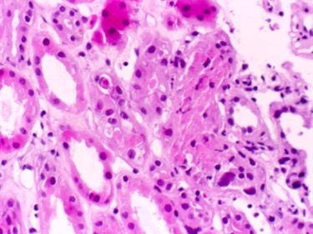
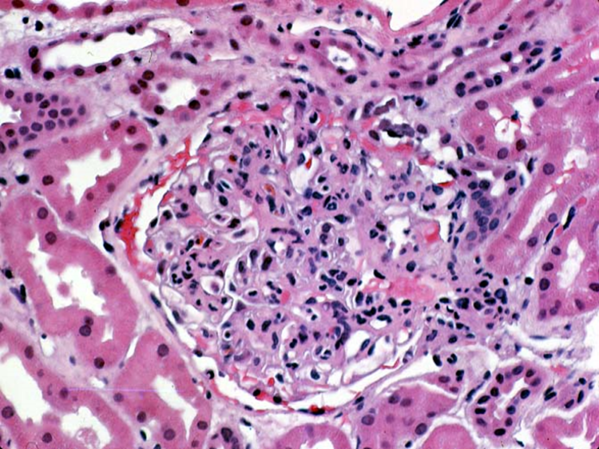
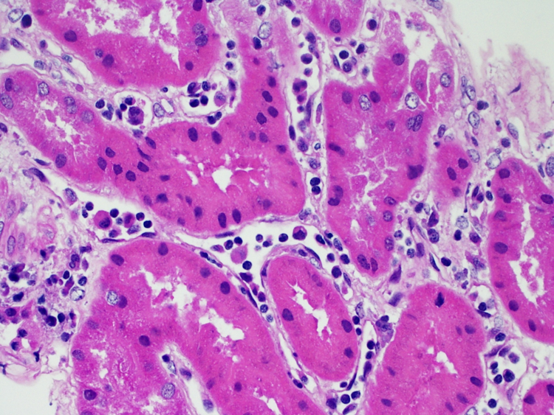
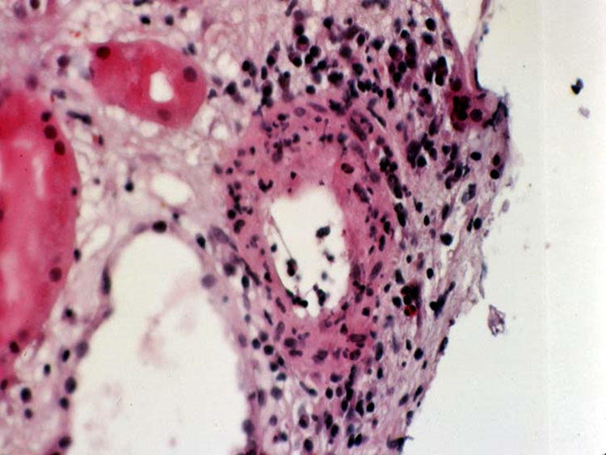
Notes:
Here are some photomicrographs on the types of ABMR:
This panel is type I: looks like Acute tubular necrosis till C4d staining is done and found to be positive.
Type 2 ABMR presents primarily as glomerulitis and characterized by presence of monos of monos in glom capill loops;
basically these mono cells are recognizing and responding to antigens expressed by endothelial cells (and possibly microscopic antigen-antibody complexes that have formed on endoth cells, although immunofluorescence studies do not show any immunoglobulin deposits in most cases)
This is also a Type 2 ABMR presenting as peritubular capillaritis: this lesion can be looked upon as the same phenomenon as glomerulitis occurring at different anatomic location in the kidney. After all the glomeruli and peritubular capillary endothelial cells express the same allogenic antigens –THIS PTC3slide is FROM HAAS FOR RACUSEN.
Type 3 ABMR here is characterized by transmural inflamm and fibrinoid necrosis. This is a very serious lesion and can be viewed as a death sentence for the graft

Slide 6
Definition of Glomerulitis: Banff 2019
Presence of >1 leukocyte
AND
Associated Endothelial swelling
Occluding >50%
1 or more capillary loops
Notes:
The diagnosis of any type of ABMR is critically dependent on the presence of the defining lesions. Therefore, it will be worthwhile examining some of these definitions, beginning with Banff 2019 defn of Glomerulitis
Glomerulitis is defined as:
The presence of >1 leukocyte ---AND-- associated Endothelial swelling
Occluding >50% --of 1 or more capillary loops.
xxxxxxxxxxxxxxxxxxxxxxxxxxxxxxxxxxxxxxxxxxxxxxxxxxxxxxxxxxxxxxxxxxxxxxx
NONE OF These are RIGHT OR WRONG PER SE. IF YOU HAVE A LOW THRESHOLD FOR diagnosing glomerulitis, you MAY identify 90% OF ALL CASES WITH clinically significant ABMR-----BUT you will also diagnose ABMR in many cases that may not need therapeutic intervention in terms of plasmapheresis, ivig or rituximab.
Total occlusion easier to dx but not sensitive
Original version of the 2013 slide talked about: An asterisk being has added to this definition as a reminder to rule out recurrent/denovo glomerulonephritis before attributing glomerulitis to ABMR .
This asterisk is there in the 2013 ABMR cheat sheet but not in the 2015 definitions table

Slide 7
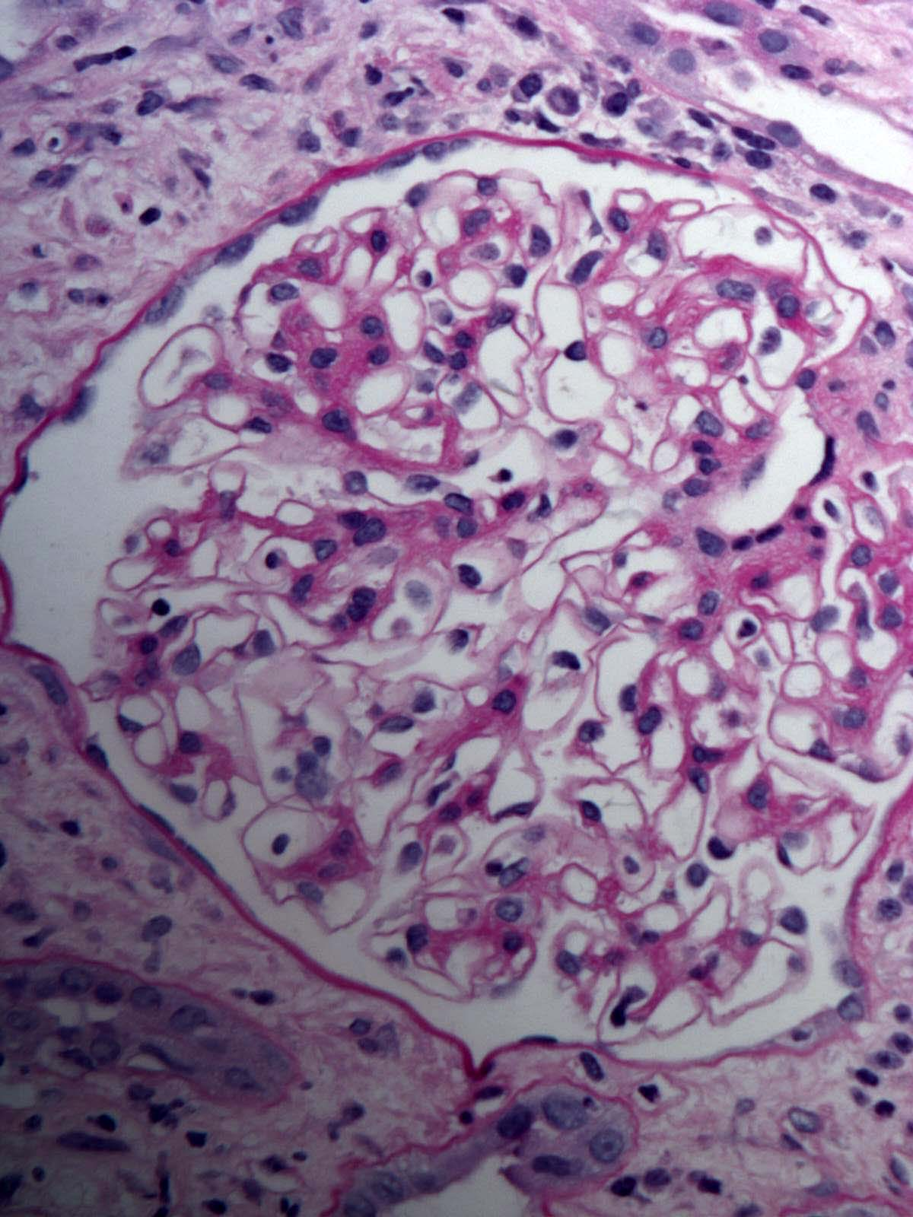
Leucocytes >1 in whole glomerulus
>50% occlusion not objective
Notes:
At the first read, this definition looks pretty precise and well thought out.--------------
However, the range of inflammatory changes seen in clinical practice is rather broad.-----------It is not uncommon to be in the position of not being able to decide whether or not a particular glomerulus fits this definition.
For example, in the glomerulus shown here----the criterion of requiring more than 1 leukocyte--- is fulfilled at the whole glomerulus level, ----but not at the level of the individual loops
I say that because NONE OF the capillary loops have HAVE MORE THAN ONE LUMINAL leukocyte
The >50% luminal occlusion rule is also NOT AS OBJECTIVE AS IT SOUNDS, ----as it will depend on the PLANE OF SECTIONING ----as well as the CONFOUNDING EFFECT of capillary dilatation in ABMR injury
THIS capillary here SHOWS A GREATER PERCENTAGE of luminal occusion than this one----EVEN THOUGH both contain A LEUKOCYTE with the SAME CELLULAR DIAMETER
xxxxxxxxxxxxxxxxxxxxxxxxxxxxxxxxxxxxxxxxxxxxxxxxxxxxxxxxxxxxxxxxxxxxxxxxxxxxxxxxxxxxxxxxxxxxxxxxxxxxxxxxxxxx

Slide 8
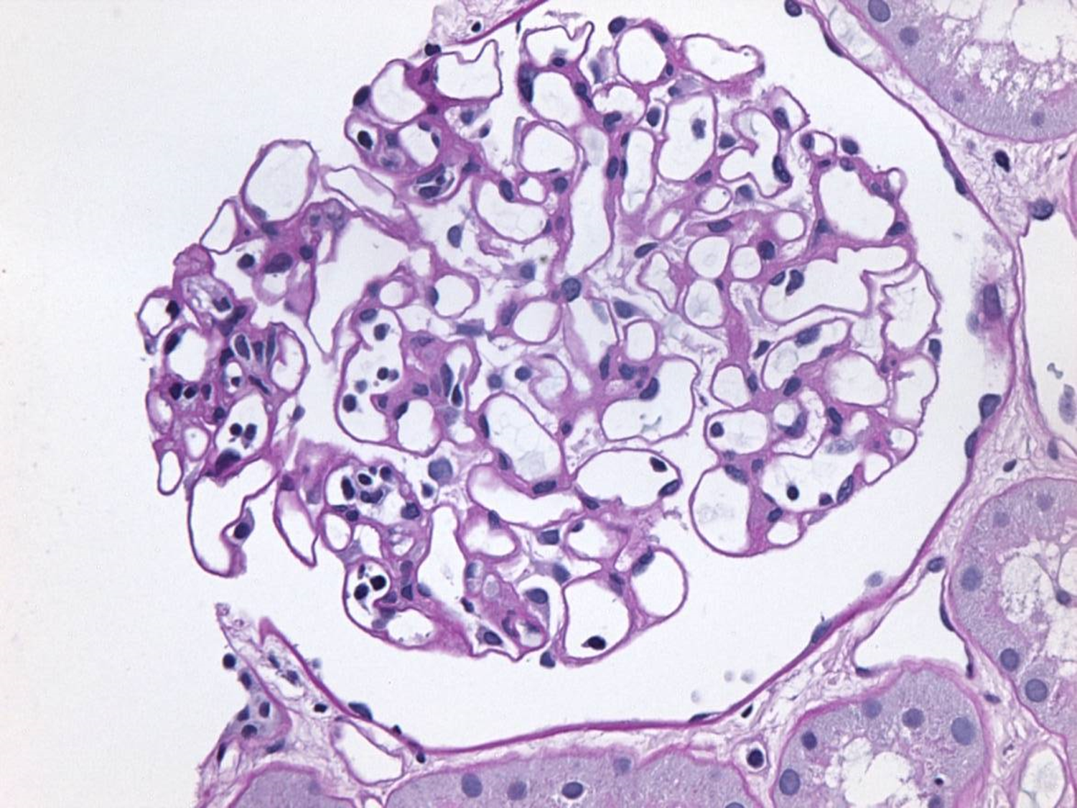
>1 in individual capillaries
CD31 vs CD68 not practical
Notes:
Now let us look at this second glomerulus.
The criterion of more than 1 leukocyte is fulfilled -----even at the level of individual capillaries. –Look at this capillary—it has at least 5 leukocytes.
However, this glomerulus brings out a 2nd problem that I want to draw your attention to.
USING JUST LM, ---it is not always easy to decide ---if we are dealing with endothelial swelling or a macrophage just resting on the luminal surface of the capillary
This capillary here illustrates this conundrum----and makes you wish you had a way of VIRTUALLY STAINING IT WITH BOTH CD31 and CD68 ---to determine its cellular lineage
In the recently concluded Banff meeting--- I was a little bit relieved to be able to find some patholgists who –LIKE MYSELF--do not insist that endothelial swelling be present for the diagnosis of glomerulitis

Slide 9
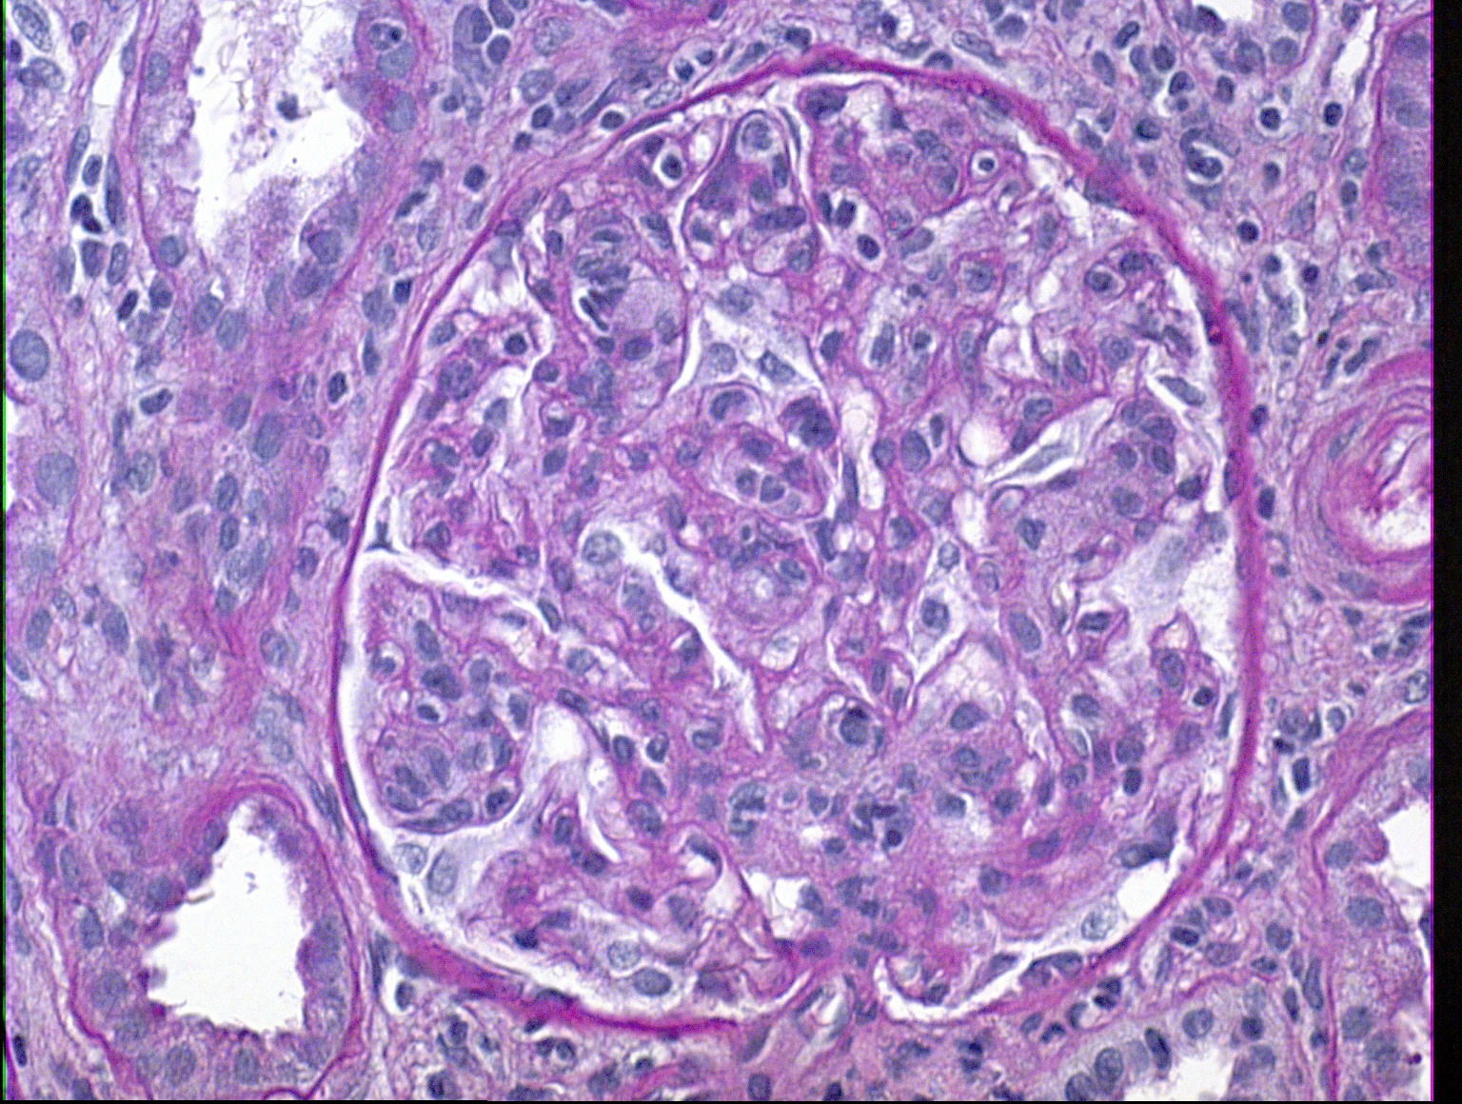
Both criteria +ve
Threshold too high
Notes:
Finally, let us look at this 3rd glomerulus
Most capillary loops fulfil the leucocyte count criterion--- as well as the endothelial swelling criterion -----at the individual capillary level. ----------Virtually all pathologists will concur that this represents glomerulitis.
However, if the threshold for calling g is set at this level ------only the Biopsies with late ---and possibly irreversible---- ABMR will get diagnosed.
Conversely, if glomeruli with a very low threshold are designated as having glomerulitis,---you may end up diagnosing cases that ----MAY not be ABMR
OR—if they are ABMR---these might be the very early cases ---that do not necessarily progress to significant graft injury.
xxxxxxxxxxxxxxxxxxxxxxxxxxxxxxxxxxxxxxxxxxxxxxxxxx
The BOTTOM LINE is that in difficult biopsies with equivocal pathology-----You have to put the pathology findings in clinical context: -----------are we dealing with a protocol biopsy or an indication biopsy? ------Is the C4d positive? -----Are DSAs detectable?
When in doubt say so; Hariharan does not lose his sleep when I tell him I can’t decide; Patient stable, C4d negative, DSA negative---no adverse outcome or medical malpractice suit is going to take place-----the earlier you confess to your colleague that pathology is not a perfect science the happier you will be
UNFORTUNATELY, CURRENTLY AVAILABLE MOLECULAR TESTS----in my opinion----were not DEVELOPED WITH SUFFICIENT RIGOR----to help in these difficult cases.
The way these tests were developed----cases with low grade glomerulitis and peritubular capillary lesions----were not normalized by a central read
Molecular Classifiers were TRAINED TO ACCEPT ALL THESE LESIONInfact, even ptc
XXXXXXXXXXXXXXXXXXXXXXXXXXXXXXXXXXXXXXXXXXXXX
.
That explains why g-grades are variable from center to center
correlations of glomerulitis grade with clinical outcome are imperfect--------and variable from center to center
xxxxxxxxxxxxxxxxxxxxxxxxxxxxxxxxxxxxxxxxxxxxxxxxxxxxxxxxxxxxxxxxxxxxxxxxxxxxxxxxxxxxxxxxxxxxxxxxxxxxxxxxxxxx
2015 argument: (before definition became more rigorous in 2019)
NONE OF THESE THRESHOLDS IS RIGHT OR WRONG PER SE.
BUT IF YOU use the threshold in the left panel, for diagnosing glomerulitis, you MAY identify 90% OF ALL CASES WITH clinically significant ABMR-----BUT you will also diagnose ABMR in many cases that may not need therapeutic intervention in terms of plasmapheresis, ivig or rituximab.
On the other hand, if you ignore glomerulitis till it reaches the level shown in the right panel, you are only going to diagnose ABMR at a stage where the chances of treating it successfully are low

Slide 10
Grading of Glomerulitis
Based on % glomeruli affected
(g1 g2 g3 respectively 0-25%, 26-50%, >50%)
Problematic Biopsies
- % loops affected does not parallel # glomeruli
(1 capillary loop given the same weight as 100%)
- %ages are sensitive to total # glomeruli
(mild 2/10 glomeruli is g1, 3/10 is g2)
Notes:
The grading of glomerulitis is also not a straight forward process.
As you know, it is based on % glomeruli affected-----------(g1 g2 g3 grades—represent 0-25%, 26-50%, >50% of the glomeruli being affected---respectively)
Problematic Biopsies are certainly encountered in clinical practice
(In some, the) % loops affected does not parallel # glomeruli affected
(To keep it simple---1 capillary loop affected has to be given the same weight ---as 100% of the capillaries affected ---in determining whether or not a particular glomerulus has glomerulitis )
- (another problem is that the) %age of glomeruli affected are sensitive to total # glomeruli in a bx
-(To give you an example: mild glomerulitis in 2/10 glomeruli qualifies as g1, -----where as just one more glomerulus, ---or 3/10 glomeruli affected ------elevates the score to g2)
Xxxxxxxxxxxxxxxxxxxxxxxxxxxxxxxxxxxxxxxxxxxxxxxxxxxxxxxxxxxxxxxxxxxxxxxxxxxxxxxxxxxxxxxxxxxxxxxxxxx
NONE OF THE definitions IS RIGHT OR WRONG PER SE. IF YOU HAVE A LOW THRESHOLD FOR diagnosing glomerulitis, you MAY identify 90% OF ALL CASES WITH clinically significant ABMR-----BUT you will also diagnose ABMR in many cases that may not need therapeutic intervention in terms of plasmapheresis, ivig or rituximab.
Total occlusion easier to dx but not sensitive
Xxxxxxxxxxxxxxxxxxxxxxx
Original version of the 2013 slide talked about: An asterisk being has added to this definition as a reminder to rule out recurrent/denovo glomerulonephritis before attributing glomerulitis to ABMR .
This asterisk is there in the 2013 ABMR cheat sheet but not in the 2015 definitions table

Slide 11
Peritubular Capillaritis
ptc0 – at least 1 leucocyte in <10% of CORTICAL ptcs
&/OR max # of leucocytes is <3
10% criterion is applied irrespective of peak count
ptc1 – at least 1 leuco in ≥10% AND 3-4 in most severe
ptc2 – 5-10 leucocytes in most severely involved ptc
ptc3 - > 10 leucocyte
-Avoid subcapsular-i, pyelo, necrosis
-Ignore interstitial leucocytes, medullary vasa recta
Notes:
Let me also make a few comments about peritubular capillaritis
ptc is graded as ptc0 – if there is at least 1 leucocyte--- in <10% of CORTICAL ptcs-----&/OR --THE max # OF LEUCOCYTES is <3
The <10% CRITERION IS APPLIED IRRESPECTIVE OF PEAK COUNT
Ptc1 refers to biopsies with – at least 1 leuco in ≥10% of cortical ptcs---AND--- 3-4 in THE most severely involved peritubular capillary
For ptc2 you need 5-10 leucocytes in most severely involved ptc
And ptc3 needs > 10 leucocytes
-In grading ptc we should avoid areas that are subcapsular, --or have evidence of pyelonephritis-- or necrosis
- We should also Ignore INTERSTITIAL leucocytes ----and those in the medullary vasa recta ----which can show some infiltrates in the setting of ati ------(although one could consider scoring here if the C4d stain is positive)
Xxxxxxxxxxxx
Proposal For Scoring PTCi Published in Banff 2003 (Am J Tx 2004:4:1562)
Presumably it is this original reference that suggests use of asterisks: -* Only mononuclear cells seen - Neutrophils said to be more specific

Slide 12
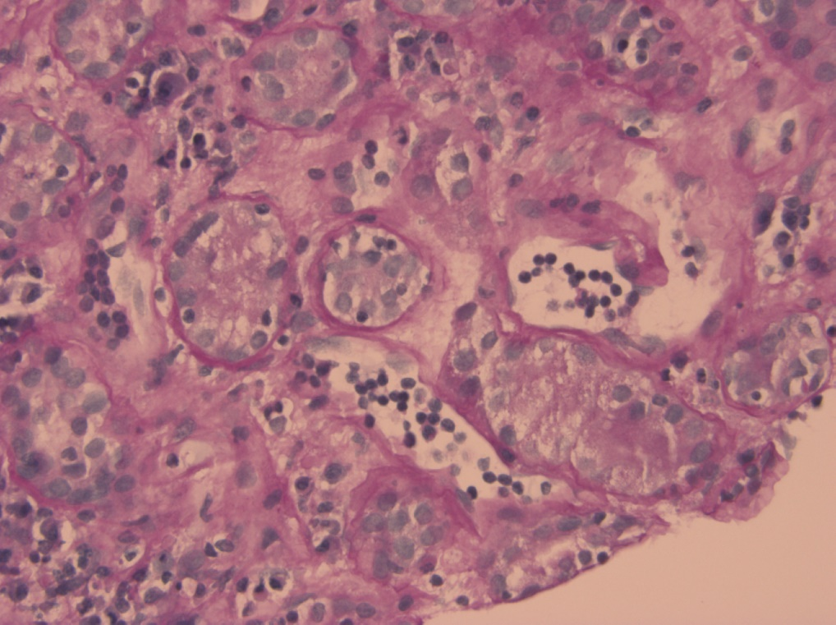
.
Problems in scoring arise on using the most involved capillary
Most biopsies,-- if positive,-- are PTC2, even if you correct for tangential sectioning
Relatively few biopsies have a score of PTC1
- g+ptc>1 criterion ABMR is a rather low threshold, fulfilled in most TCMRs
Increasing recognition of MVI with –ve C4d & no DSA
Notes:
PROBLEMS in scoring some biopsies arise----when we use the most severely involved peritubular capillary
Eg the biopsy on the left ---and that on the right--- would get the same score even though the biopsy on the right is intuitively much more inflamed (as long as at least 10% of the peritubular capillaries have at least one leuko).
This issue is Being addressed by a Banff Working Group---by subcategorizing peritubular capillaritis as as focal and diffuse--- but setting a binary 50% threshold to make this distinction does not completely solve the issue
Another problem for me Personally is that,-- MOST of my biopsies, ---IF they are POSITIVE for peritubular capillaritis-- are ptc2, EVEN IF YOU CORRECT FOR TANGENTIAL SECTIONING, eg by drawing a line perpendicular to the long axis of the oval shape, and count only the number of cells in contact with that line
Relatively few biopsies have a ptc score of 1 -------since on looking around I can always find a capillary with 3 leukocytes.
So to me--- the grading system has a very lopsided distribution of scores (which limits is usefulness as a prognostic factor, unless focal/diffuse nature added) ----- G+ptc>1 criterion for ABMR ----is fulfilled in most TCMR biopsies (& that is why Banff rules insist on g being present in that setting)(also the reason molec microscope diagnoses ABMR more commonly than histology—because the underlying classifiers were trained to accept even low grade peritubular capillary occurring alone as a criterion for molec diagnosis ABMR)
The g+ptc > 1 is A RATHER LOW THRESHOLD-----in my opinion, ---and provides at least one explanation---for the INCREASING RECOGNITION OF MICROVASCULAR INFLAMMATION ----WITH NEGATIVE C4D ----and NO DSA
Parenthetically, I should add that:--Banff rules DO NOT ALLOW PTC >1 ALONE to be used as a criterion for ABMR---when TCMR (or bl) is present.
There is an additional requirement for glomerulitis---but as I have noted,--- the lowest grades of glomerulitis ----ARE DIFFICULT TO ADJUDICATE WITHOUT REFERENCE TO THE CLINICAL CONTEXT
XXXXXXXXXXXXXXXXXXXXXXXXXXXXXXXXXXXXXXXXXXXXXXXXXXXXXXXXXXXXXXXXXXXXXXXXXXXXXXXXXXXXXXXXXXXXXXXXXXXXX
Peritubular capillary3 score is not common---- if only the orthogonally—as opposed to longitudinally—cut peritubular capillaries ar evaluated for the presence of 11 or more leucocytes

Slide 13
Case Presentation#1 Early acute ABMR phenotype
.
Notes:
I will now pass on to the case Presentation 1
Like all the other cases, it is ---what I might call—a synthetic Constructs created for educational purposes

Slide 14
Clinical History Case 1
25 yr old multiparous female
+ Flow cytometric XM
Desensitization Rx (PP, Ritux, Splenectomy)
Rise of serum creatinine 3.6 on day 12
Notes:
25 yr old multiparous female
+ fcm xrm which indicated the presence of Pre-existing DSA
Desensitization Rx given prior to transplant in the form of (PP, Ritux, Splenectomy)
On follow up a Rise of serum creatinine to 3.6 was observed on day 12

Slide 15
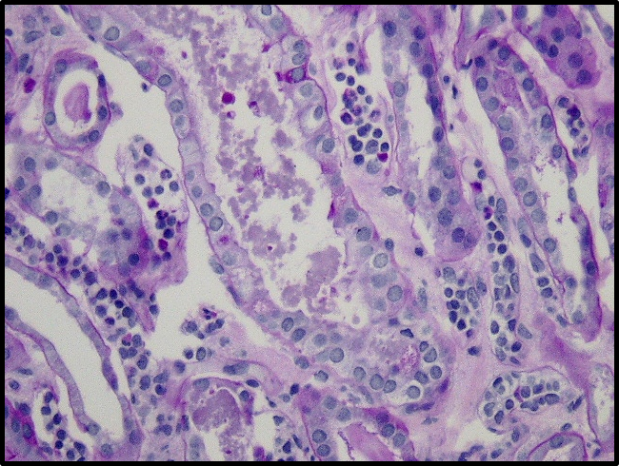
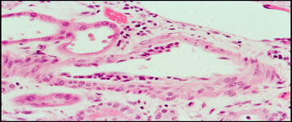
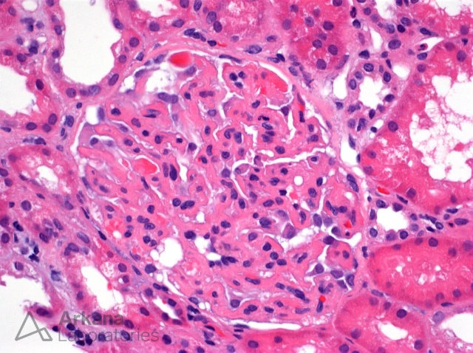
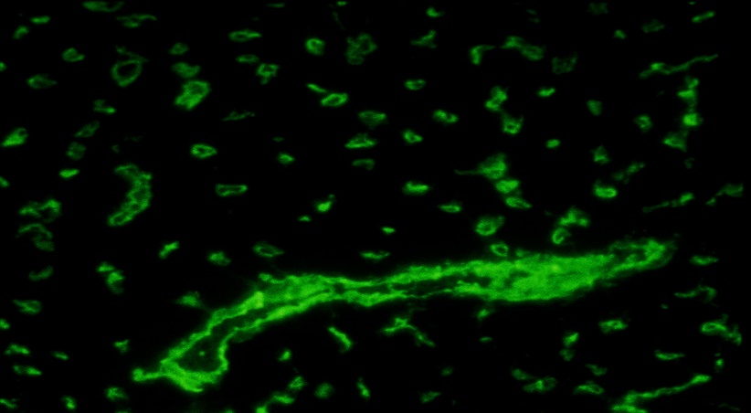
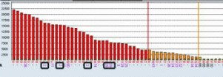
Notes:
Here are the key biopsy findings (laser pointer)
The biopsy showed Acute tubular injury and a very focal peritubular capillaritis
There was a V-lesion in the form of intimal arteritis
Arteriolar thrombi were present
Diffuse C4d deposition was seen in the peritubular capillaries
Multiple High titer DSAs were detected

Slide 16
Early Acute ABMR
Pre-existing DSA
Abrupt allograft dysfunction, typically 7-10 days
TTS sets limit at 30 d (definitional purposes)
Due to a memory B-cell response, causes graft loss within days if not treated
Prophylactic Rx Eculizumab reduces risk
Notes:
This is a case of early acute ABMR.
It is characterized by:
Pre-existing DSA
Abrupt allograft dysfunction, typically 7-10 days
TTS sets limit at 30 d (for definitional purposes)
It is Due to a memory B-cell response, causes graft loss within days if not treated
Prophylaxis with Rx Eculizumab reduces risk of ABMR in xrm+ patients
Xxxxxxxxxxxxxx
Here I should add that most patients with pre-exis DSA do not present with early acute ABMR, of which case 1 was an example. Many are subclinical, mild acute or indolent in nature

Slide 17
IF Findings in Eculizumab Rx Biopsies
MicAb binds to & inhibits cleavage C5→ 5a 5b
Action downstream of C4
C5-Ecu complex glomeruli/TBM reacts IgG2, G4, K
IgG subclass staining needed in post-Rx Cd+ MVI- biopsies
Notes:
The IF Findings in Eculizumab Rx Biopsies are interesting.
Ecu binds to and Inhibits cleavage of C5→ 5a 5b
This action is downstream of C4—which means that C4d deposits will be seen even if activation of the terminal pathway has been inhibited by this rx
C5-Ecu binding complex deposited in the glomeruli and tbms reacts with IgG2, IgG4, Kappa
Thus, igg2 and igg4 subclass staining is needed in post-rx biopsy is C4d+ MICROVASCULAR INFLAMMATION-Negative biopsies . This prevents misinterpretation of +C4d in these biopsies as evidence of active abmr
Xxxxxxxxxxxxxxxxxxxxxxxxxxxxxxxxxxxxxxxxx
humanized monoclonal antibody ----granular staining pattern for IgG2 and IgG4 heavy chains and kappa light chain.

Slide 18
Case Presentation #2 “Late” Acute ABMR Phenotype De novo DSA
.

Slide 19
Clinical History Case 2
Age 15 y
Negative CDC and flow XRM
Kidney from 25 y deceased donor
CIT 10 hours
Presented with creatinine 3.2 at 7 months
Tac levels low normal range
Admitted to periodically missing medications
Notes:
This was a patient of Age 15 y
He had a Negative CDC and flow XRM
The Kidney was from a 25 y deceased donor
The CIT was 10 hours
He presented with a serumCreatinine 3.2 at 7 months
The Tac levels were in the low normal range
The patient Admitted to periodically missing medications

Slide 20
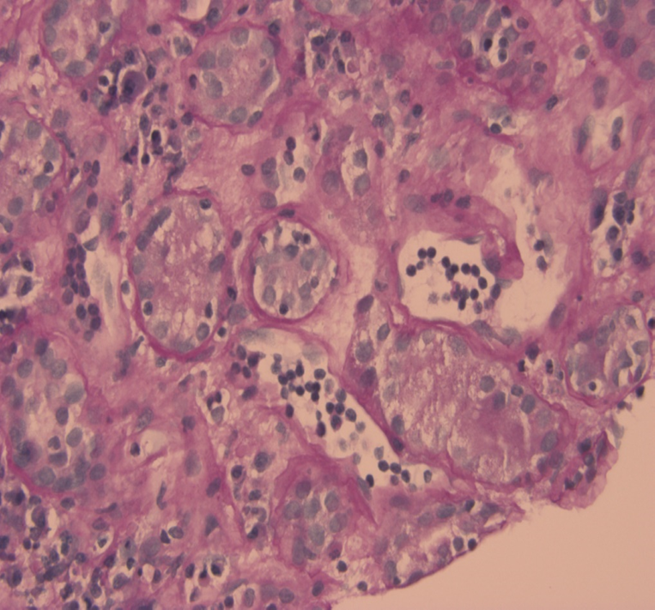
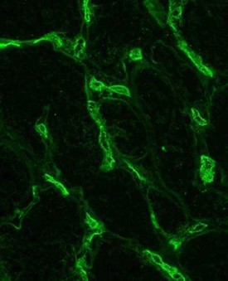
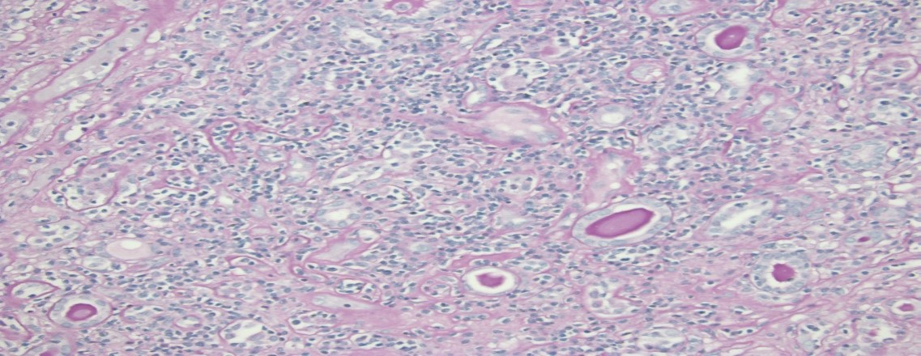
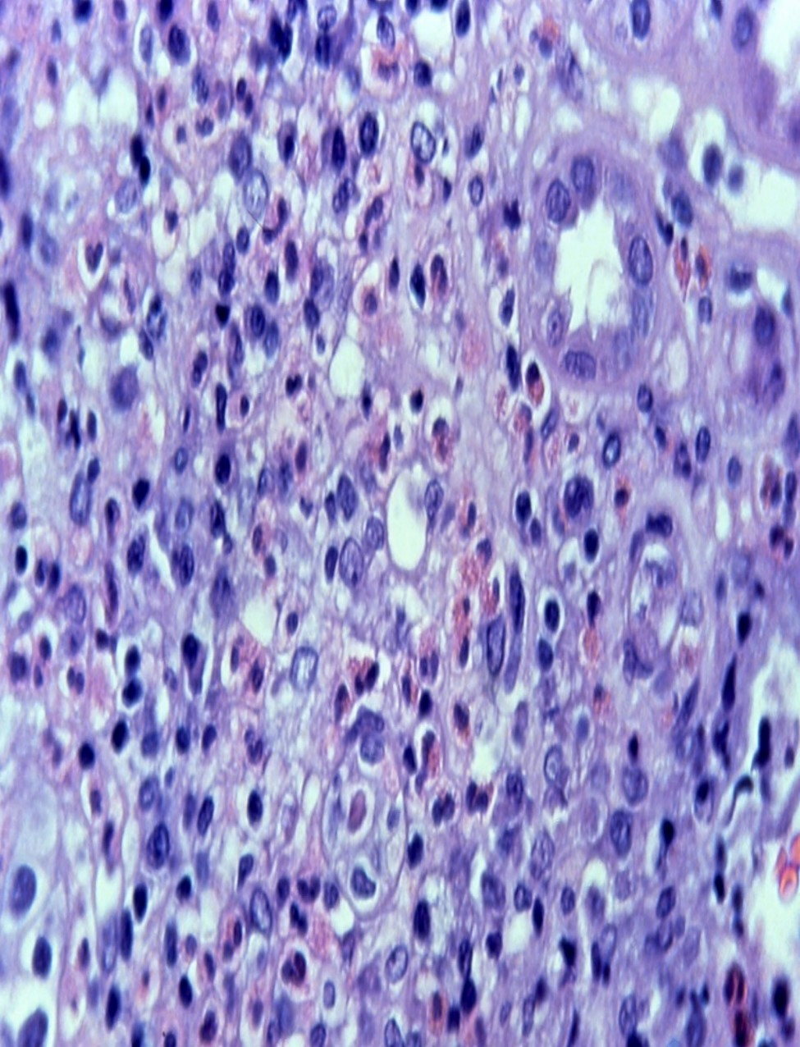
Notes:
Salient feature of the biopsy were: glomerulitis, peritubular capillaritis, diffuse C4d, and class II DSAs
In contrast to case 1, there was also diffuse i/stt inflamm and tubulitis.
Hpf showed prominent eos, but there were no recent changes in the patient’s medications
Xxxxxxxxxxxxxxxxxxxxxxxxxxxxxxx

Slide 21
“LATE” ACUTE ABMR De Novo DSA
Commonest type, r/o “late” ABMR Pre-exis DSA
Presents typically >3m, rise creatinine/proteinuria
Inadequate I.S. (compliance, iatrog, PhK, genetic)
Grafts function for months to years
Path: active or caABMR, C4d +/-, class II DSA
Concomitant TCMR frequently present
Notes:
This is a case of “LATE” ACUTE ABMR due to De Novo DSA
It is the Commonest type of ABMR encountered in practice, since many surgeons will not preform transplantation in patients with known DSA, -------By definition a diagnosis cannot be made unless we have-r/o Pre-exis DSA.
Patients present typically >3m post-tx, as a rise creatinine/proteinuria
Inadequate I.S. is the usual clinical setting (this may be due to compliance issues,--- iatrogenic reduction due to infection, malignancy, or intentional weaning, ----Pharmacokinetic issues due to drug interactions---- or genetic variability in metabolism of cni or azathioprine)
Grafts function for months to years
Pathology shows an active or caABMR, ----C4d may be + or negative, class II DSA is often found
AND Concomitant TCMR frequently present

Slide 22
Many Biopsies Labeled as ABMR are Mixed Acute TCMR- active ABMR
Incidence a center-specific variable
Lower end estimates mixed rejection: 6%
Higher end: 43% early, 63 % late ABMR
--90% at UPMC if we include BL
Demographics, immunosuppression.
Lack of attention to i-IFTA→ under calling late caTCMR
Predicts graft loss --- even after correction ci, C4d, DSA
Notes:
I want to use this case to make a very imp point, viz that Many Biopsies Labeled as ABMR are ACTUALLY Mixed Acute TCMR- active ABMR
The reported incidence of mixed TCMR-ABMR appears to be a center-specific variable
- Lower end estimates are that mixed rejection is seen in 6% of all ABMR biopsies
-At the higher end one study quotes an incidence of 43% for early and 63% for late ABMR
-----These figures rise to 90% at Univ Pittsburgh Med Ctr, if we include BL category (not unreasonable since in some studies even subclinical inflammation is a risk factor for CAMR and late graft loss)
Potential explanations for the apparently marked variations in incidence include --different patient demographics, AND varied immunosuppression protocols,
Another important problem is that inflammation in areas of IFTA is not reported by most pathologists, and leads to undercalling of chronic TCMR in late biopsies
This is an important issue since such inflammation -----Predicts graft loss, even after correction for fibrosis, positive C4d staining, and presence of donor specific antibodies (25).
xxxxxxxxxxxxxxxxxxxxxxxxxxxxxxx
With respect to the pathogenesis mixed rejection, examination of a single biopsy cannot determine whether (a) ABMR occurred first with a secondary influx of T-cells, or (b) whether TCMR exposed epitopes which then elicited antibody formation (27). Clinically, it has been observed that ABMR can be preceded by one or more episodes of TCMR (11, 28), some of which may be subclinical (29, 30). Conversely, the presence of DSA at implantation is associated with subsequent TCMR (31), which affects graft outcome (32). There is not enough hard data available at this time to determine how often antibodies precede T-cell influx and vice versa. It is likely that both scenarios exist but their relative frequency is unknown. Molecular studies show that the burden of cytotoxic T lymphocytes in TCMR can be comparable to ABMR (33).
It is important to recognize that TCMR and ABMR are not mutually exclusive diagnoses. ------------Indeed, the classical paper by Feucht, which heralded much of the current literature on ABMR, was a demonstration of C4d staining in biopsies with TCMR (6) . ----------The actual incidence of mixed TCMR-ABMR appears to be a center-specific variable with low end estimates approximating 6% (10, 17). ----------Hopkins acute rejection <3 m 28/38 or 74% mixed KID INT 2014:87:409)----Lefaucheur lancet 2013: 381: 313 interstitial inflammation in 72% ABMR-v and 45% actually misclassified as TCMR initially----they did give steorids, plasmapheresis, ritux but not ATG which may have helped---At the other extreme, in a series of 67 ABMR biopsies from Norway, 63% of early and 96% of late ABMRs biopsies had concurrent TCMR, if borderline changes were included in the analysis. If only TCMR Banff grade 1A or higher was analyzed, 43% of early and 48% of late biopsies satisfied the criteria of mixed rejection (22).----------- Likewise, in a recent study of antibody mediated vascular rejection, approximately two thirds had an inflammation + tubulitis sum score >3 and could be construed as mixed rejection (13). This is not just a semantic point because this series of patients had an ~40% graft survival after ABMR treatment. Arguably, this clinical outcome could have been improved if T-cell depleting therapy had also been administered consistently.
Potential explanations for the apparently marked variations in incidence of mixed rejection include different patient demographics, varied immunosuppression protocols, and lack of uniform diagnostic criteria. Some investigators ignore T-cell infiltrates that fall in the Banff borderline category. ----This may not be necessarily correct in all cases, since even subclinical inflammation is a risk factor for CAMR and late graft loss (19, 23).----------- Another confounding element in determining the true incidence of mixed TCMR-ABMR is the presence of inflammation and tubulitis in areas with scarring. Literal application of the Banff Schema in this setting can results in under-diagnosis of TCMR in at least 33% of such biopsies (24). This is problematic as it is now clear that T-cell inflammation in areas of tubular atrophy is a strong predictor of graft loss, even after correction for fibrosis, positive C4d staining, and presence of donor specific antibodies (25). Molecular studies have confirmed that patients with progressive chronic diseases express high levels of acute kidney injury transcripts (25, 26).-------------------------With respect to the pathogenesis mixed rejection, examination of a single biopsy cannot determine whether (a) ABMR occurred first with a secondary influx of T-cells, or (b) whether TCMR exposed epitopes which then elicited antibody formation (27). Clinically, it has been observed that ABMR can be preceded by one or more episodes of TCMR (11, 28), some of which may be subclinical (29, 30). Conversely, the presence of DSA at implantation is associated with subsequent TCMR (31), which affects graft outcome (32). There is not enough hard data available at this time to determine how often antibodies precede T-cell influx and vice versa. It is likely that both scenarios exist but their relative frequency is unknown. Molecular studies show that the burden of cytotoxic T lymphocytes in TCMR can be comparable to ABMR (33).

Slide 23
Rx Interventions in TCMR +/- ABMR
 | Steroids | Steroids + anti-T | HR
TCMR-V0 (139) | 100% | 0% | 1.0
TCMR-V (26) | 73% | 19% | 1.5 = NS
ABMR–V0 (73) | 0% | 0% | 2.93
ABMR-V (64) | 28% | 17% | 9.07
 | 2/3rd i+t >3
.x
Optimal Rx regimens need careful future studies
Dichotomizing every bx as ABMR/TCMR not conducive to implementing rational therapy
Notes:
The clinical implications of recognizing mixed rejection are brought out-----by this data on rx interventions implemented in biopsies with-- TCMR with or without ----concurrent ABMR
In biopsies with a diagnosis of TCMR with no arteritis ie --a V score of zero---, steroids were given in 100% of cases, and the hazard ratio graft loss was assigned a value of 1.0 (although 15% of patients still lost their grafts in this group, this was not statistically different from a control group with no documented TCMR)
-In biopsies with TCMR and intimal arteritis ---which can occur in grade 2A TCMR as well as in ABMR---73% got steroids and an additional 19% got anti-T-cell treatment; -----HR for graft loss was 1.5; deemed not to be statistically significant [73+19% = 92%; the remaining 8% got ABMR namely steroids & IVIG but not plasmapheresis or ritux)
-Importantly in ABMR without v-lesions, NONE OF THE 73 PATIENTS got any T-cell therapy & the HR graft loss was 2.93
In the ABMR=vasculitis category, only 28% of patients got steroids, and 17% got anti-Tcelll treatment; the HR for graft loss after primarily IVIG/ritux based treatment was 9.07
IT IS VERY IMPORTANT TO NOTE that 2/3RD of the biopsies with ABMR had an i+t score of >3---- and likely---- had a significant component of associated tcmr; ------It is not unreasonable to suggest that the prognosis here might have been better if some T-cell therapy had been given.
THIS DATA SUGGESTS THAT:
optimal treatment regimens for patients with mixed ABMR NEED MORE CAREFUL FUTURE STUDIES.
dICHOTOMIZING EVERY BIOPSY INTO TCMR AND ABMR IS NOT CONDUCIVE TO implementing rational therapy
(FYI:: 100% of ABMRs ?without V got steroids (many with IVIG and Ritux that I have not tablulated here but for Nadiad I made a separate ABMR-centric table);
XXXXXXXXXXXXXXXXXXXXXXXXXXXXXXXXXX
Suppll. fig 3--- You must note that classfiying vasculitis and implementing plasmapheresis, IVIG, rituximab did show perceptible differences in graft survival already; these measures are important; the issue is more T-cell therapy will make it better
A balanced argument may be the best way to counter clinicians who may get up and say already know steroids and atg do not work-----(might ask them if they combined with ritux ivig, or considered that too heavy a hit–-- also we need to leave the door open for safer T-cell therapies in the future
If somebody offers data saying the reverse, thanks for sharing your experience; I think it will be desirable that similar data be collected from other medical centers, to see if the conclusions apply to more diverse populations, under different immunosuppressive regimens
xxxxxxxxxxxxxxxxxxxxxxxxxxxxxxxx
the mean i-score was even higher, ie about 1.3 (estimated by me from the graphs in the paper, & mean implies some cases were higher), and surely these T-cells were contributing to tissue injury, even if for the sake of argument we accept that the influx of T-cells in ALL of these biopsies was secondary to antibody injury, ALTHOUGH in reality at least some of these biopsies might have started out as TCMR, which might have been the sensitizing event that led to antibody formation
.
Xxxxxxxxxxxxxxxxxxxxxxxxxxxxx
Odds ratio of 2.0 in logistic regression is a increase in probability eg from 1/3=0.33 to 2/3=0.66 (and importantly it can not double if already more than 0.5)
Hazard ratio of 2.0 in Cox regression means event will occur twice as more often (can happen even if probability is >0.5; corollary is that OR and HR in favor of an event are similar if probabilities are low)

Slide 24
Pathogenesis Mixed AcTCMR-active ABMR
Bidirectional relationship
ABMR→ influx T-cells (DSA precedes Bx- TCMR 20%: simply reflect higher testing frequency)
TCMR→21% DSA mean 4.4 m later (Loupy: Tx 2015: 99: 965)
Relative importance of the 2 pathways difficult to determine in clinical practice
Actual sequence of events not relevant
Notes:
Must be a COOT point: There is not enough hard data available at this time to determine how often antibodies precede T-cell influx and vice versa. It is likely that both scenarios exist but their relative frequency is unknown. Molecular studies show that the burden of cytotoxic T lymphocytes in TCMR can be comparable to ABMR (33).
xxxxxxxxxxxxxxxxxxxxxxxxxxxxxxxxxxxxxxxxxxxxxxxxxxxxxxxxxxxxxxxxxxxx
examination of a single biopsy cannot determine whether (a) ABMR occurred first with a secondary influx of T-cells, or (b) whether TCMR exposed epitopes which then elicited antibody formation (27). Clinically, it has been observed that ABMR can be preceded by one or more episodes of TCMR (11, 28), some of which may be subclinical (29, 30). Conversely, the presence of DSA at implantation is associated with subsequent TCMR (31), which affects graft outcome (32). There is not enough hard data available at this time to determine how often antibodies precede T-cell influx and vice versa. It is likely that both scenarios exist but their relative frequency is unknown. Molecular studies show that the burden of cytotoxic T lymphocytes in TCMR can be comparable to ABMR (33).staining, and presence of donor specific antibodies (25). Molecular studies have confirmed that patients with progressive chronic diseases express high levels of acute kidney injury transcripts (25, 26

Slide 25
CASE 2 FOLLOW UP BIOPSY 6M LATER Chr Active Mixed ABMR-TCMR Phenotype
Notes:
I want to show a follow up biopsy from this patient after an interval of 6 months

Slide 26
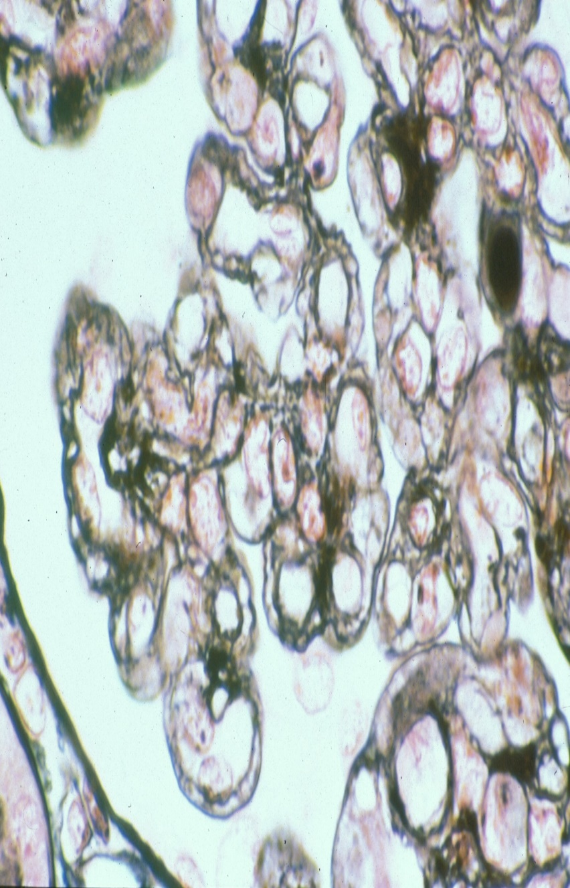
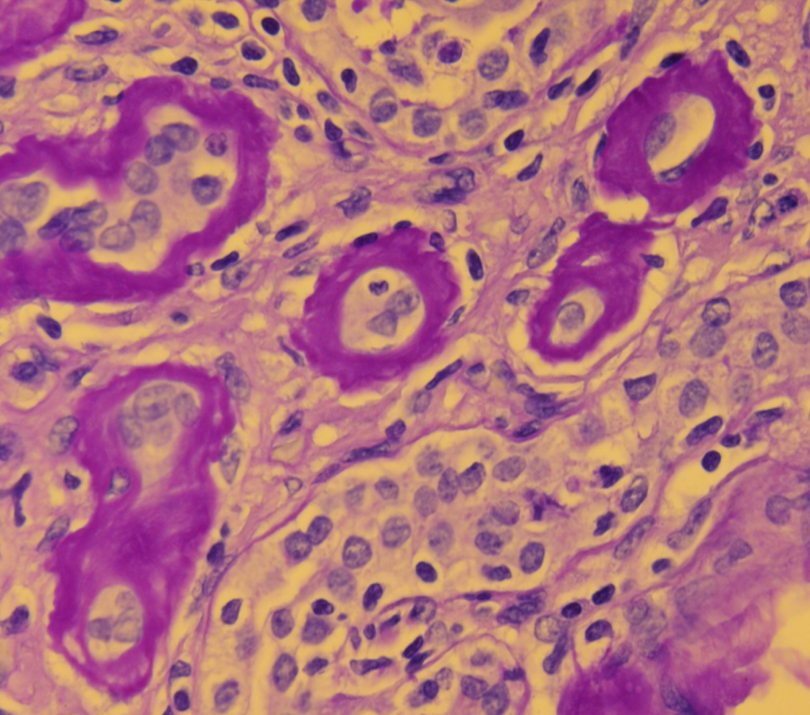
UnRx acABMR---Mixed Ca TCMR – Chr ABMR
iIFTA =3
i-B & t-B: N/A
C4d +ve
DSA +ve
Notes:
1
The point I want to make is that even treated active ABMR can culminate in mixed ca TCMR and chronic ABMR.
The left panel shows that ongoing glomerulitis has led to extensive double contouring of the glomerular capillary loops: this is the lesion we call chronic transplant glomerulopathy, and is a diagnostic criterion for chronic active or chronic inactive ABMR
The middle panel brings out extensive i-IFTA with a score of 3. -------i-Banff & t-Banff scores could not be assigned as THERE WERE NO AREAS WITHOUT IFTA ---- c4d and DSA were positive, as they were at the time of the initial biopsies
RIGHT PANEL----------At hpf I was able to find t2 tubulitis in moderately atrophic tubules -----even though other tubules nearby were severely atrophic----------------So I made a diagnosis of chronic active TCMR on top of chronic active ABMR,---- so that it becomes a mixed chronic active ABMR and TCMR .
xxxxxxxxxxxxxxxxxxxxxxxxxxxxxxxxxxxxxxxxxxxxxxxxxxxxxxxxxxxxxxxxxxxxxxxxx
The discrepancy between the pathology and the clinical findings was -----that the nephrologist had made a diagnosis of ACUTE TCMR.
This is not really a discrepancy if we keep in mind that ----chronic active TCMR can HAVE AN ACUTE RISE OF CREATININE---& for therapeutic purposes – SOME OF THESE PATIENTS can be considered an ACUTE TCMR superimposed on IFTA.
PARENTHETICALLY,--- Banff rules allow for a diagnosis of ACUTE TCMR ----only if sufficient inflammation and tubulitis are found in non-scarred areas (though mild atrophy surrogate for mild IFTA is apparently allowed), ----but I frequently see CLINICALLY ACUTE TCMR in a biopsy that shows inflamm and tubulitis only in fibrotic areas-----------IN FACT WHEN THE Banff 2017 defn of ca-TCMR was formulated, ONE COMPETING PROPOSAL THAT GOT VOTED OUT---was that the report these cases out as acute TCMR superimposed on IFTA, ---(---only applicable if there was non-scarred tubulitis)
INDEED a Banff survey indicated that many clinicians agree with this approach, though most = 80% treat at least some of these patients with steroids (64% do not ROUTINELY treat acute TCMR in this setting)
Unfortunately, I am aware that some clinicians latch on to the word chronic in a pathology report that mentions ca-TCMR and may decide that it is futile to intervene, in cases that are not yet endstage.---That is not a problem as long as you understand that there is active ongoing injury potentially responsive to enhanced immsup.
Unfortunately, not all clinicans get that message. Some will latch on to the word chronic and may decide it is futile to intervene.
Banff 2017 did not allow a diagnosis of acute TCMR in the presence of IFTA. It accepted tubulitis irrespective of its location in scarred or unscarred areas
Bannf 2019 rules for ca-TCMR have not been changed, but they do allow separate scoring of tubulitis in unscarred areas, and a statement on whether or not conventional criteria for acute rejection are also satisfied in the biopsy

Slide 27
Banff 2019 Criteria for Chr. Active TCMR
Total i > 1
I-IFTA >1
t >1 – in at least 2 foci in areas w/wo IF and TA
- concurrent BL/Acute should be diagnosed if w/o IFTA
- clearly stated that severely atrophic tubules excluded
Reasonable exclusion other causes t & i-IFTA
Grade 1A if t-IFTA =2, Grade 1B if t-IFTA =3
Grade II if we can demonstrate chronic allograft arteriopathy
Notes:
To refresh your memory about the Banff criteria for ca-TCMR. These require:
Total-inflammation score be >1
I-IFTA or inflammation in fibrosis score be >1
And that the t- score be >1, in at least 2 foci in areas w/wo IF and TA
- concurrent BL change or acute TCMR should be dx if w/o IFTA
-it is clearly stated that we must not score severely atrophic tubules
We need reasonable exclusion of other causes of t and iifta
Once that is done we can grade the ca-TCMR as grade 1A if t =2, Grade 1B if t =3
XXXXXXXXXXXXXXXXXXXXXXXXXXXXXXXX
Table 4 footnote e: It was felt by the majority of Banff 2019 meeting attendees that reporting of chronic active TCMR should be accompanied by a second diagnosis of borderline acute TCMR or acute TCMR (with appropriate grade) when criteria for both diagnoses are met.
Table 5 Acute and chronic scores footnote: Although the tubulitis score (1-3) is based on the single most severely involved tubule, at least mild tubulitis must be present in ≥2 cortical foci for a t score >0 to be assigned. Severely atrophic tubules should NOT be scored;
BRIAN WAS CONCERNED 20% SCARRED AND 80% SCARRED BIOPSIES BOTH GET A CHRONIC SCORE OF 1A—BUT IF THE BIOPSY REPORT IS READ IN CONJUNCTION WITH CI, CT AND i-IFTA SCORES---------AND REMEMBERING THE CICT2 MINIMUM THRESHOLD FOR DX
xxxxxxxxxxxx
note that new onset is not required for chronic ACTIVE TCMR, though in my proposal for chronic INACTIVE TCMR I must propose it)
Xxxxxxxxxxxxxxxx
(artery intimal fibrosis with mononuclear cell inflammation in fibrosis & formation neointima)
Do not want to restrict it to chronic scores of >=2 but not doing so means confusing the issue with BL change and mild ifta from donor in a 3 month protocol biopsy– plus the BL infiltrate should prompt upward adjustment of immunosuppression anyway if clinically indicated

Slide 28
Post-Treatment Biopsy
Notes:
1
Chronic active ABMR does not necessarily get treated if there is extensive chronicity, as was the case here.
Because of the inflammation and tubulitis, we did elect to treat TCMR by pulse steroids.
Here is a comparison of pre & post-transplant biopsies from this patient -----The original biopsy is on the left ----and the post treatment biopsy on the right.
There was a reduction in inflammation and tubulitis WITHIN THE SCARRED AREA
xxxxxxxxxxxxxxxxxxxxxxxxxxxxxx

Slide 29
Banff 2017-2019 CHRONIC active ABMR
Needs all 3 of the following criteria:
Morphologic evidence of CHRONIC tissue injury
Ab-E interaction criteria for Dx of active ABMR
Serologic criteria for Dx of active ABMR
Am J Transplant 2018: 18: 293 and 2020: 20: 2318
Notes:
I want to use this case of chronic mixed rejection to discuss the entity of chronic active ABMR
This diagnosis Needs all 3 of the following criteria to be fulfilled
Morphologic evidence of CHRONIC tissue injury should be present, and thatI will describe in the next slide
Ab-Endothelial interaction criteria used for the Dx of active ABMR need to be present in CHRONIC ACTIVE ABMR TOO
Finally, the Serologic criteria for Dx of ACTIVE ABMR also apply to CHRONIC active ABMR
Xxxxxxxxxxxxxxxxxxxxxxxxxxx
First enunciated 2017 (ajt 2018) and edited in 2019 meeting (ajt 2020)

Slide 30
Chronic Tissue Injury in Chronic Active ABMR
1. cg>0 if no evidence GN/chronic TMA
2. Art intimal fibrosis, new onset, exc other causes
leucocytes within sclerotic intima not required
favor chronic ABMR if leucocytes present
provided no prior history of TCMR (present also in chronic TCMR)
3. Severe PTCML (PTCML 1, needs EM)
Notes:
The criteria for Chronic Tissue Injury in Chronic Active ABMR are listed here:
The first one is Chronic transplant glomerulopathy with a cg score>0 if there is no evidence GN/chronic TMA
The second one Arterial intimal fibrosis, new onset, excluding other causes eg donor disease, hypertension,
leucocytes within sclerotic intima may be present but are not required (Gary Hill)
Biopsy favors chronic ABMR if leucocytes are present
provided there is no prior history of TCMR (leucocytes can also be in chronic TCMR)
The third lesion is Severe PTCML (PTCML 1, needs EM)
Xxxxxxxxxxxxxxxxxxxxxx
Note that PTCML is a Banff sanctioned abbreviation since 2019 meeting
xxxxxxxxxxxxxxxxxxxxxxxxxxxxxxxxxxxxxxxxxxxxxxxxxxx
NB: (Leukocytes within sclerotic intima may be present in chronic ABMR or chronic TCMR: footnote #10 in 2013 table)
Haas review Curr Opin Nephrol Hypertens 2018: 27: 137 Table1 notes that leucocytes are present but are not required for chronic ABMR (gary hill non-specific arteriosclerosis); I think the same rule needs implemented for chronic TCMR
xxxxxxxxxxxxxxxxxxxxxxxxxxxxxxx
Chronic active is the overall term though some are acute on chronic and need urgent treatment if mild chronicity
cg0 versus cg1 is also a subtle change; overall agreement in cg scores between 3 pathologists is 67% (specifically 0 versus 1 not available and likely to be even higher)(Smith et al, stegall, Transplant In 2018: 32 173)
Discrepancy has little clinical significance as no therapy is triggered by the call
xxxxxxxxxxxxxxxxxxxxxxxxxx
Clinical dysf is required by nih pane; others recognize subclinical acr

Slide 31
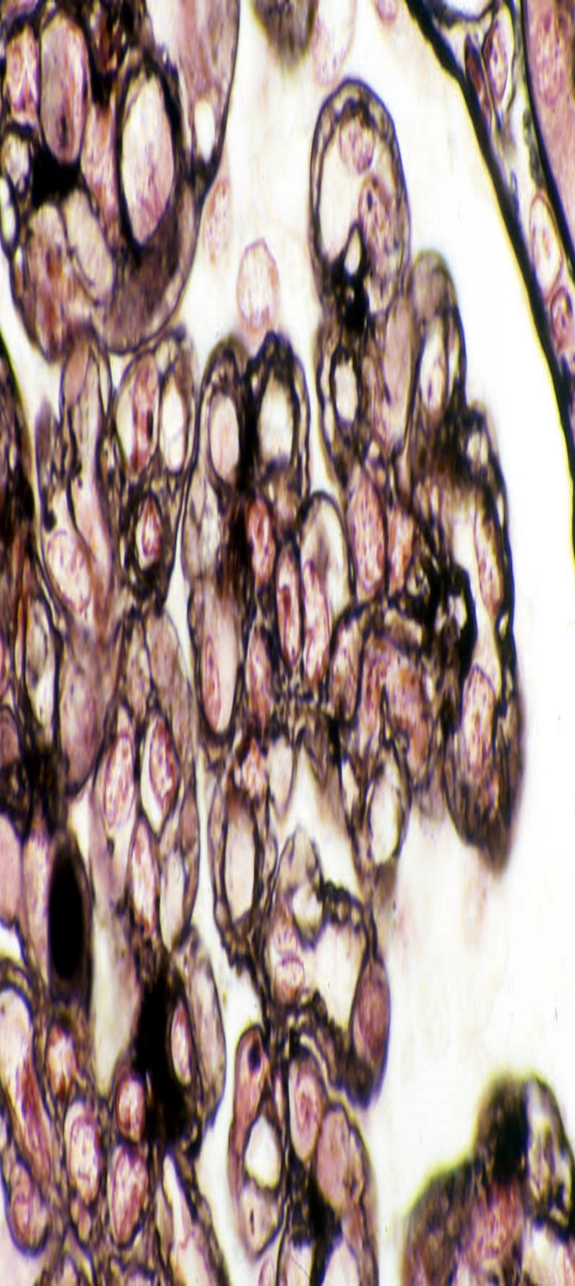
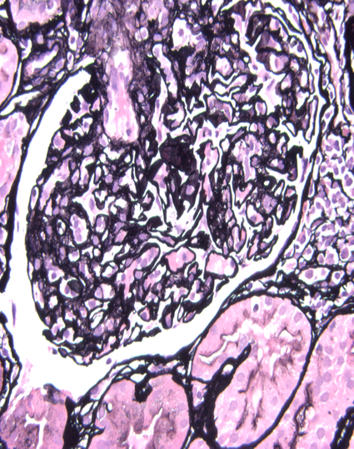
Notes:
I will now briefly ILLUSTRATE the lesions of chronic tissue injury in ABMR starting with chronic transplant glomerulopathy
The Left panel shows a typical example: of duplicated glomerular basement membranes, on the PAS stain, --which at least in my department, becomes available within 6 hours of performing a biopsy.
Middle panel shows a silver stain, which comes out the next day in OUR WORK FLOW. -- It confirms our PAS stain findings in many cases.
However, we USE a AUTOMATED STAINER in our lab,--- and not infrequently, the slides comes out overstained. ---
At other times the GBMs are understained as seen here.

Slide 32
Grading of Chronic Tx Glomerulopathy (Banff 2013)
cg0 no double contours LM or EM
cg1a appreciated only by EM (minim 3 loops)
cg1b: one or more GCs with double contours in ≥1 non-sclerotic glom by LM
- ultrastruct confirmation recomm if EM available
cg2 and cg3 >25% & >50% capillary loops in most involved glomerulus
Notes:
Grading of cg IS imp since higher grades are associated with proteinuria and graft loss. Banff 2013 recommends scoring it on a scale of 0-4
cg0 refers to no double contours in glomerular capillary loops by LM or EM
cg1a can be appreciated only by EM and requires that changes be present in a minimum of 3 glomerular capillary loops
-we need to see GBMs with Double Contours—that can be incomplete or circumferential
- and should be accompanied by endoth swell ----&/or--- translucent widening
cg1b: is characterized by one or more GCs with double contours--- in ≥1 non-sclerotic glom by LM
- ultrastruct confirmation is recommended if EM is available
cg2 and cg3 refer to >25% & >50% Double Contours in THE MOST INVOLVED glomerulus

Slide 33
Guidelines for EM Evaluation of cg: Banff 2019
EM if no double contours visible on LM
Examine minimum 1 glom >5000x
State how many examined/involved
Avoid partially sclerosed, severely ischemic
Notes:
I noted that grade Cg1a can only be recognized by em; Here are some guidelines for em evaluation of cg
EM is indicated only if no double contours visible on LM, and there is need to evaluate early changes of chronic transplant glomerulopathy (eg for a trial or proteinuria)
We must Examine a minimum of 1 glomeruli at a magnification of >5000x
The Pathology report should State how many examined/involved
We should avoid partially sclerosed & severely ischemic glomeruli in our assessment
Xxxxxxxxxxxxxxxxxxxxxxxxxxxxxxxxxxxxxxxxxxxxxx
Minimal criteria for diagnosis are presence of -----> 3 cap loops in a single glom, each showing:
- subendothelial neo-densa GBM (single or multiple layers, circumferential or not)---AND
- Endothelial cell enlargement –AND/OR- - Subendothelial electron-lucent widening
XXXXXXXXXXXXXXXXXXXXXXXXXXXXXXXXXXXXXXXXXXXXXXXXXXXXXXXXXXXXXEndothelial cell enlargement = increase in cytoplasm, decrease in the capillary luminal area and loss of fenestrations.
This should be used rather than less precise or incorrect terminology such “endothelial swelling”, “reactive endothelial changes”, “endothelial activation”, “endothelial injury” or “endothelial cell degeneration”.
Subendothelial electron-lucent widening= expansion of space between the ---glomerular endothelium ----and lamina densa---- of the glomerular basement membrane (GBM) by electron-lucent material.
This should be used instead of “lamina rara interna expansion” or “subendothelial rarefaction”.
Subendothelial neo-densa glomerular basement membrane = .single or multiple basement membrane layer(s) clearly distinct from the original GBM.
.

Slide 34
Minimum Criteria for cg1a: Banff 2019
> 3 cap loops in a single glom, each showing:
- subendothelial neo-densa GBM (single or multiple layers, circumferential or not)---
AND
- Endothelial cell enlargement
AND/OR
Subendothelial electron-lucent widening
Notes:
The Minimal criteria for diagnosis of cg1a are listed here.
We need are presence of > 3 cap loops in a single glom, each showing:
- subendothelial neo-densa GBM (single or multiple layers, circumferential or not)---
AND
- Endothelial cell enlargement
–AND/OR- -
Subendothelial electron-lucent widening
XXXXXXXXXXXXXXXXXXXXXXXXXXXXXXXXXXXXXXXXXXXXXXXXXXXXXXXXXXXXXEndothelial cell enlargement = increase in cytoplasm, decrease in the capillary luminal area and loss of fenestrations.
This should be used rather than less precise or incorrect terminology such “endothelial swelling”, “reactive endothelial changes”, “endothelial activation”, “endothelial injury” or “endothelial cell degeneration”.
Subendothelial electron-lucent widening= expansion of space between the ---glomerular endothelium ----and lamina densa---- of the glomerular basement membrane (GBM) by electron-lucent material.
This should be used instead of “lamina rara interna expansion” or “subendothelial rarefaction”.
Subendothelial neo-densa glomerular basement membrane = .single or multiple basement membrane layer(s) clearly distinct from the original GBM.
.

Slide 35
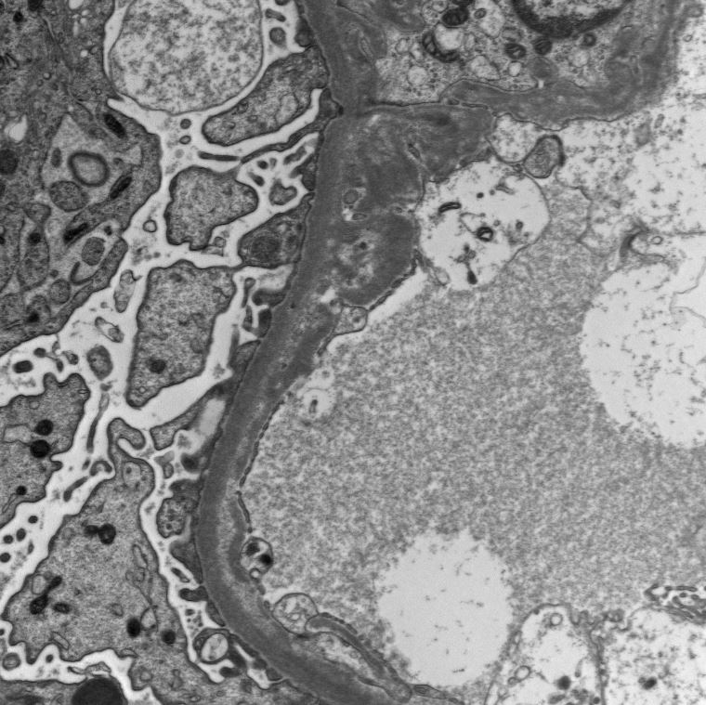
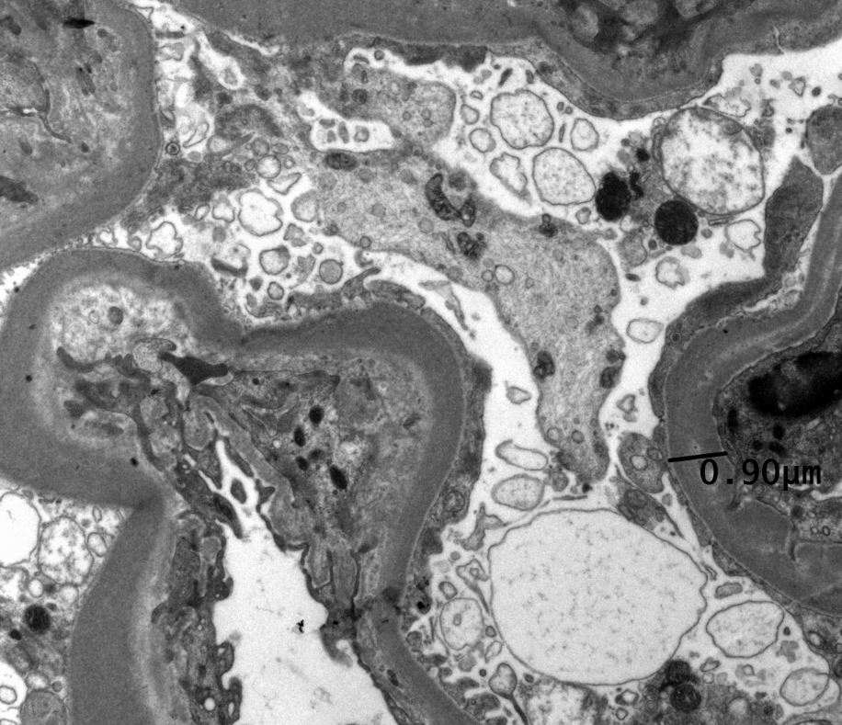
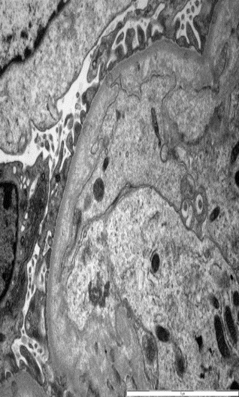
Notes:
Here are some examples
Left panel shows an early cg1a lesion—with a very thin zone of s/endothelial translucency. There is also duplication of the glomerular basement membranes. A thin band here, and tangential sectioning making it look much thicker here (PHS21-27957)
Middle panel: more well developed lesion
Right panel shows an advanced stage with striking mesangial interposition, which is the em counterpart of the duplicated gbm we see EVEN ON LIGHT MICROSCOPY

Slide 36
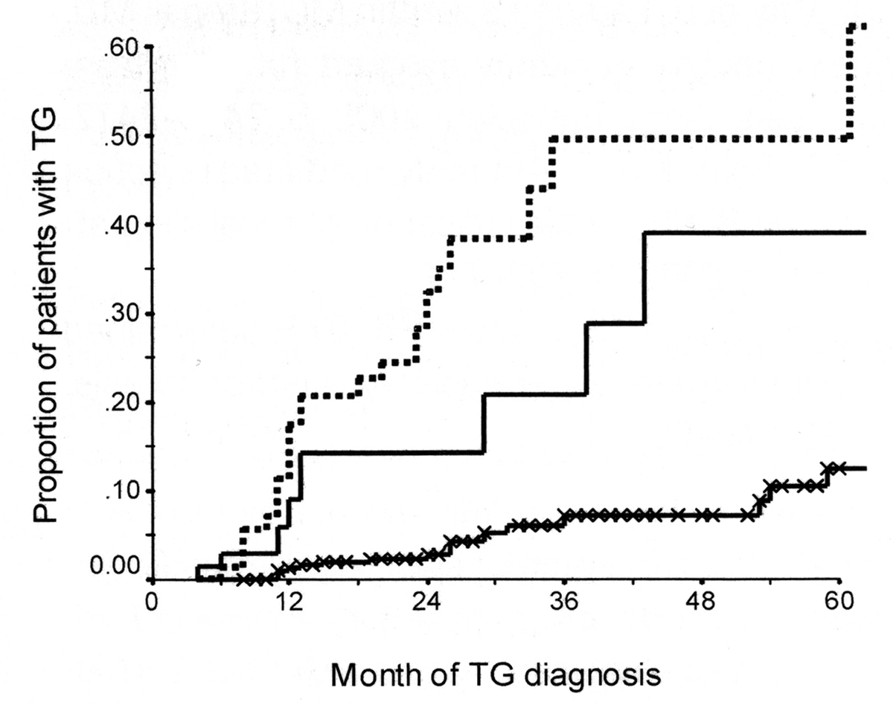
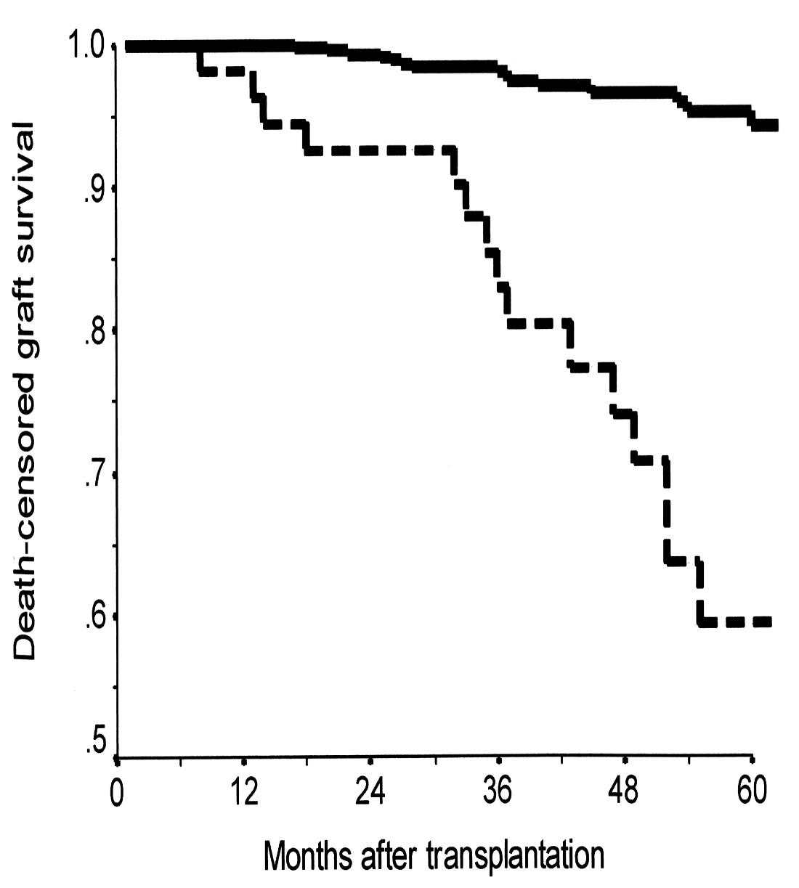
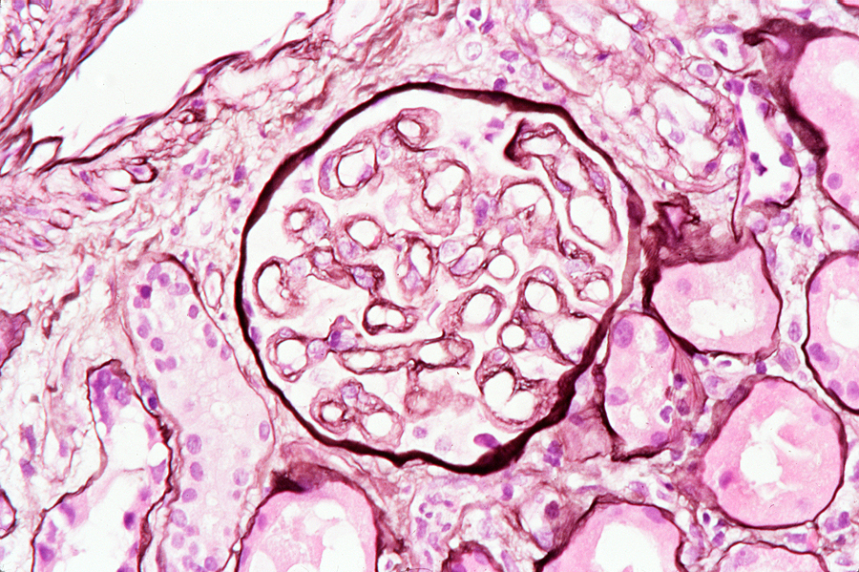
Banff 2005 Accepted cg as Criterion of CABMR
anti-Class II DSA
anti-Class II non-DSA
No anti-Class II
Gloor et al, AJT 7: 2124-32, 2007
Cosio et al, AJT 8: 492-6, 2008
Notes:
Historically, it was Banff 2005 that accepted cg as a Criterion of CABMR
The underlying rationale was that this lesion is associated with anti-HLA antibodies
-for example in this paper from Gloor et al----the prevalence of TG was about 60% at 60 months if class II DSA was present, -----about 40% if NON DSA anti-class II were present, -----and just about about 15% when no class II antibody was present.
.
Right panel: shows the DEATH CENSORED GRAFT SURVIVAL (y axis only spans the interval 0.5 to 1.0); ----If patients have no tg >95% grafts functioning at 60 months, --but if there is tg only about 50% do so(do not recall grade but any grade is probably important if the finding is clearly seen at light microscopy)
xxxxxxxxxxxxxxxx
- the x-axis shows the month of diagnosis of TG
-y axis is proportion of patients THAT HAVE DEVELOPED TG at ANY GIVEN TIME

Slide 37
Additional Evidence for Including CTG as a Criterion for Chronic ABMR
20-70% have C4d in peritubular capillaries
Microarray analyses often show increase in ENDATs= endothelial associated transcripts
BUT
Data also shows not all cases have C4d or DSA
M ay not be ABMR but TCMR, MPGN, TMP
Notes:
Here is Additional evidence for Including CTG as a Criterion for Chronic ABMR
20-70% have C4d in peritubular capillaries
Microarray analyses of the these biopsies often show Endothelium associated transcripts that are seen in classic amr
I WOULD ARGUE THAT THIS DATA ALSO SHOWS not all cases have C4d or DSA and may not be ABMR but TCMR
XXXXXXXXXXXxxxxxxxxxxxxxxxxxxxxxxxxxxxxxxxxxxxxxxxxxxxx
The significance of C4d negative cases is presently unknown; some regard these as evidence of past antibody damage (so called hit and run antibody injury) while others consider it to be an antibody independent (possibly cell mediated) mechanism of glomerular basement membrane damage; A minority of cases represent healed thrombotic microangiopathy or an immune complex disorder such as mpgn.
ENDAT seen on microarray analyses in many biopsies (limited studies, but not surprising in a capillary damage disease)
The significance of C4d negative cases has become a debatable issue: AMRloving/philiac pathologists think all cases of cg represent amr whether or not antibodies are demonstrable at the time of diagnosis; I think that is going too far;
there is really no reason why T-cells mediated immune injury can not damage glomerular capillary endothelium and result in basement membranes duplication
Xxxx
cell mediated immunity contribution could vary with immunosuppression protocol;
Monkeys correln is with amr and not tcmr

Slide 38
Case for T-CELLS Causing cg ~ 20-30% Biopsies
All glomerulitis Bxs have T-cells ranging 20-50%
g precedes CTG in serial biopsies
Tctx cells, T-bet, GzB present in bxs CTG
Tctx cell transcripts in DSA- C4d- Biopsies WITH CTG are more abundant than biopsies WITHOUT CTG
Concept same as accepting v & cv can be T-cell or Ab
Notes:
THE FOLLOWING CASE can be made FOR TCMR causing glomerulitis LEADING TO chronic transplant gm in at least 20-30% of the biopsies
-All glomerulitis Bxs have T-cells ranging from 20-50%
g precedes CTG in serial biopsies
Tctx cells, T-bet, GzB present in bxs CTG
Tctx cell transcripts in DSA- C4d- Biopsies WITH CTG ----are more abundant than--- in biopsies WITHOUT CTG
Concept same as accepting that intimal arteritis and graft arteriosclerosis can be T-cell or antibody mediated
xxxxxxxxxxxxxxxxxxxxxxxxxxxxxxxxxxxxxxxxxx
have dual etiology! We don’t argue they all have undetectable antibody or non-HLA antibody!!

Slide 39
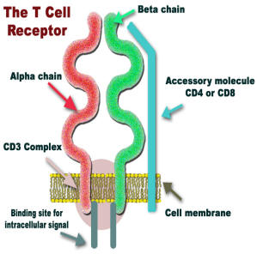
Biologic Plausibilty of T-cell Mediated Endothelial Injury
Ag recognition repertoire of T-cell pool corresponds to 10¹⁶ unique TCRs
It is expected that endothelial cells will bear antigens that can be recognized by T-cells
Some cases of C4d-ve cg & ptcml are T-cell mediated, esp those that are DSA –ve
Presence of ENDATs in these biopsies should not PER SE lead to re-classification as ABMR
Notes:
I do not believe that The BIOLOGIC PLAUSIBILITY OF T-CELL MEDIATED acute or chronic endothelial injury will BE CONTESTED BY ANY TRANSPLANT IMMUNOLOGIST
.
-We need to remember that the antigen recognition repertoire of T-cell pool corresponds to 10¹⁶ unique T-cell receptors
Therefore, It is expected that endothelial cells will bear antigens that can be recognized by T-cells
IT FOLLOWS THAT Some cases of cg and ptcmlare LIKELY T-cell mediated, ----esp those that are C4d negative and DSA –ve
IN MY OPINION, ----The presence of endothelium associated transcripts ---or ENDATs--- in these biopsies should not ---PER SE--- lead to their re-classification as ABMR.
IF T-CELLS CAN DAMAGE ENDOTHELIUM, ----ONE WOULD EXPECT ---that process to be able to upregulate ENDATs as well
XXXXXXXXXXXX
As a corollary one can say that The argument that T-cells cannot recognize ANY endothelial allograft-antigen is not logical and hard to defend
.--Yes agree some can be non-HLA endothelial but current evidence does not suggest it should be a very common phenomenon
xxxxxxxxxxxxxxxxxxxx
There is experiment evidence/Immunologists have clearly shown that
xxxxxxxx
10¹⁶ with 10⁷ unique T-cell receptors in the peripheral blood (36). There is also experimental evidence that endothelial cells can endocytose and phagocytose endogenous as well as exogenous antigens with subsequent presentation to CD4 and CD8 positive T-cells (37). ------------One would expect that expression of adhesion molecules by microvascular endothelium would lead to intra-capillary accumulation of inflammatory cells which would result in glomerulitis and peritubular capillaritis. The potential of these cells to cause tissue damage is highlighted by immunohistochemical studies that show granzyme producing T-cells in biopsies with microvascular inflammation (38). Recurrent episodes of such injury would lead duplication and multi-layering of the endothelial cells. -----------------------------This line of reasoning provides a conceptual basis for how TCMR can result in chronic transplant glomerulopathy and multi-lamellation of peritubular capillary basement membranes.
The idea that T-cells can injure glomerular or peritubular capillary endothelium is biologically quite plausible, if we keep in mind that the antigen recognition repertoire of the human T-cell pool is of the order of 10¹⁶ with 10⁷ unique T-cell receptors in the peripheral blood (36). There is also experimental evidence that endothelial cells can endocytose and phagocytosie endogenous as well as exogenous antigens with subsequent presentation to CD4 and CD8 positive T-cells (37).

Slide 40
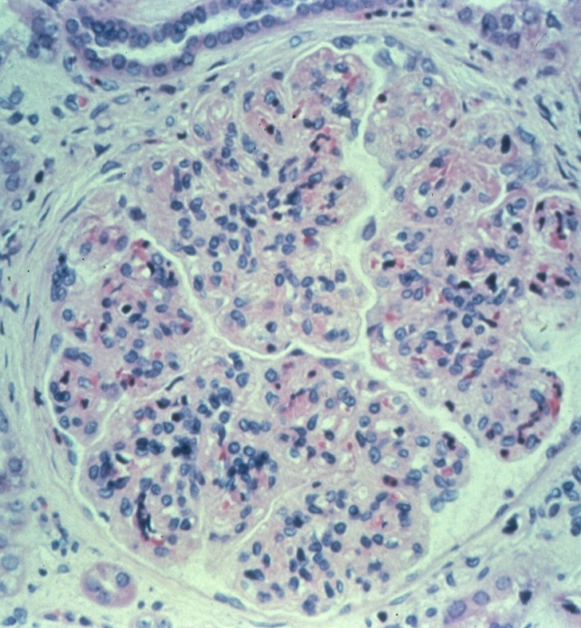
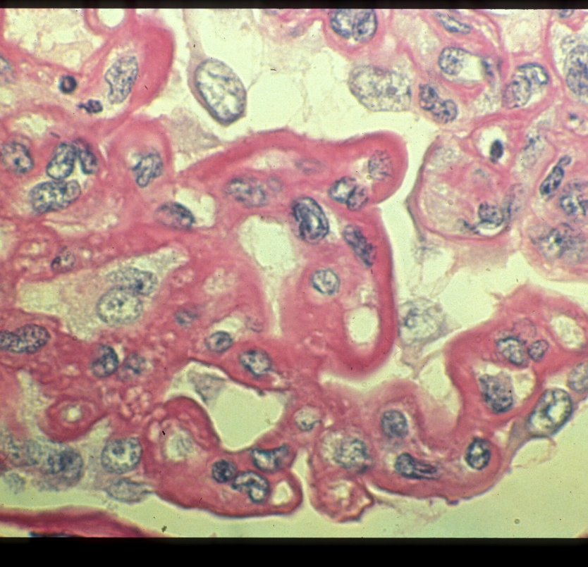
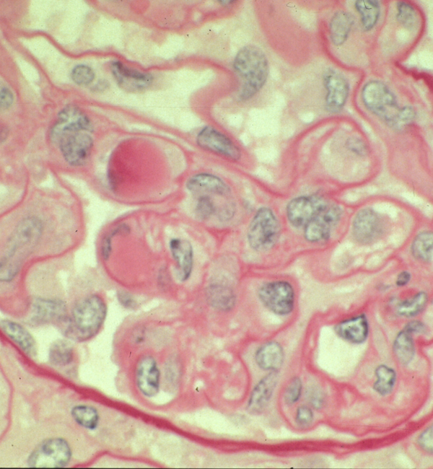
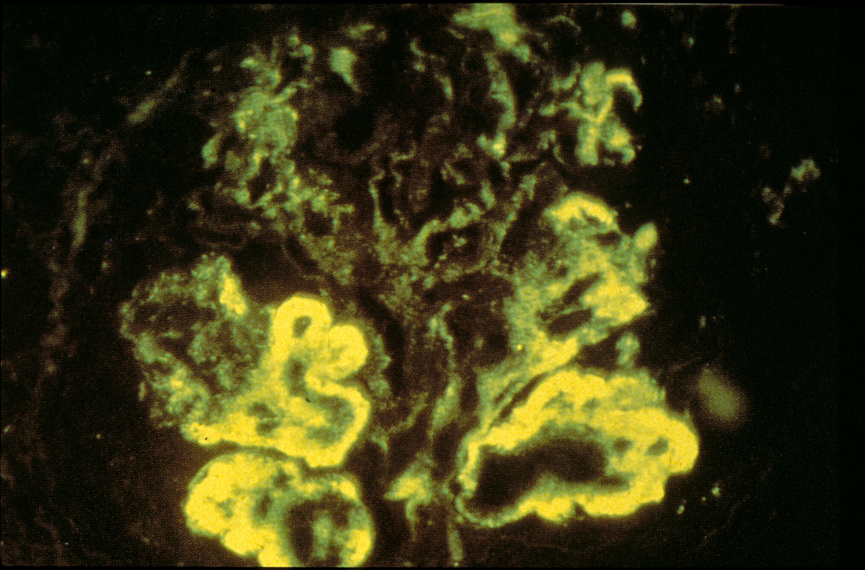
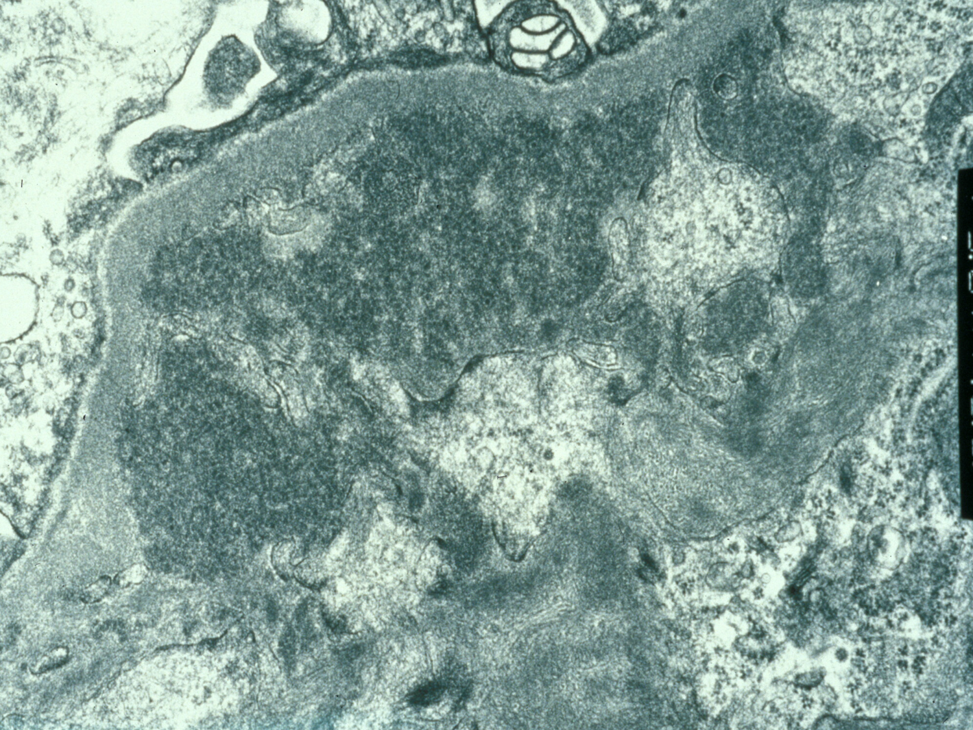
Cg due to Immune Injury
Not Related to Rejection
Notes:
There are few lesions in Pathology that are absolutely specific for one disease, and cg is no exception;
You can see Double Contoured capillaries in immune injury not related to rejection eg MPGN, SLE with wire loop lesions, and cryoglobulinemia.
All of these conditions can be readily distinguished from chronic transplant glomerulopathy by IF & em;
eg sle will show a full house immunofluorescence pattern, possibly
membranoproliferative glomerulonephritis will show abundant s/en icds on em

Slide 41
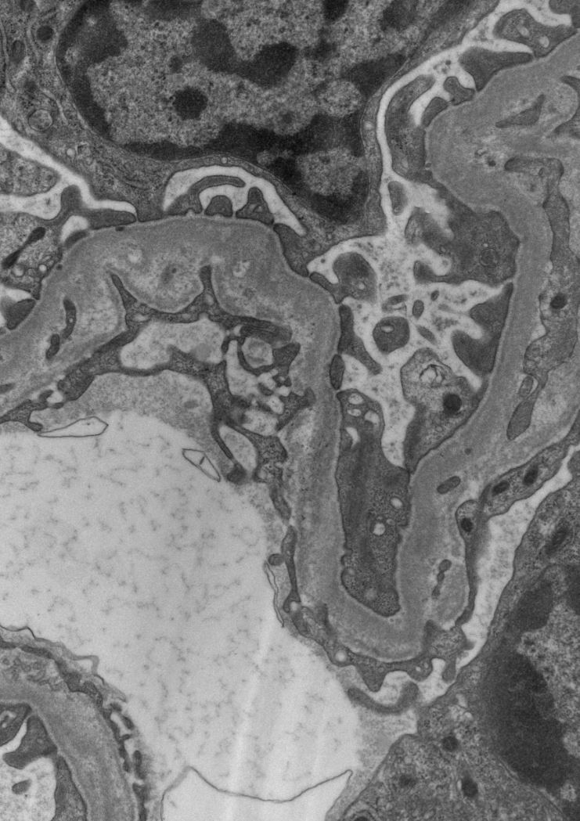
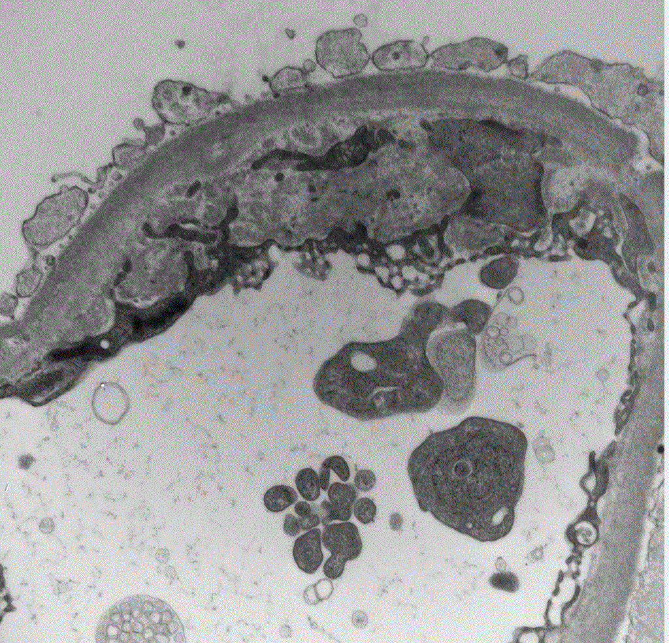
Non Immune Endothelial Injury
Hypertension Chronic TMP
Notes:
Non-immune endothelial injury can cause cg like lesions on em
We have a biopsy with chronic uncontrolled hypertension on the left side
And Chronic thrombotic microangiopathy on the right
xxxxxxxxxxxxxxxxxxxxxxxxxxxxxxxxxxxxxxxxxxxxxxxxxxxxxxx
Native thrombotic microangiopathy
Cholesterol embolism in non-transplanted kidd

Slide 42
The PTCML Lesion (Banff 2019)
Score cortex with no scarring, necrosis, hemorrhage
Examine at least 10 PTC at magnification (≥ 5000×).
Count # BM layers in the 3 worst affected PTCs
Count segment with the most layers (not tangential)
Report should state --- # PTC examined--# maximum BM layers --- whether ptcml1 threshold reached
ptcml1 = 1 PTC with ≥7 layers AND 2 PTC ≥5 layers
Notes:
The 2nd ultra-structural lesion of chronic tissue injury in ABMR is Peri Tubular Capillary Multi-lamellation
Banff 2019 offers the following guidelines for its assesment
Score cortex with no scarring, necrosis, hemorrhage
Examine at least 10 PTC at magnification (≥ 5000×).
Count # BM layers in the 3 worst affected PTCs
Count segment with the most layers (not tangential)
Report should state --- # PTC examined--# maximum BM layers --- whether ptcml1 threshold reached
A ptcml-1 score can be assigned if we see: 1 PTC with ≥7 layers AND 2 PTC ≥5 layers
Presence of ≥7 layers in one cortical PTC
And ≥5 layer in two additional capillaries-- while avoiding PTCs cut tangentially
This High threshold may be appropriate for achieving Diagnostic specificity (though waiting for a lesion to become severe—before you decide to call it--- is not conducive to early intervention)
Such Binary categorization of continuous process should also be avoided in studies intended to evaluate efficacy of anti-rejection agents (but see path correlates ahead)
xxxxxxxxxxxxxxxxxxxxx
IN ORDER TO INCREASE THE DIAGNOSTIC SPECIFICITY OF THIS LESION the PTC ML criterion for chronic ABMR has been made even more strict in the 2013 schema (ist criterion is new)
Banff 2009 simply said ‘no ptc lamination is less than 5 layers by electron microscopy’
Xxxxxxxxxxxxxxxxxxx
-Specific clinical correlates of new definition not yet available in literature

Slide 43
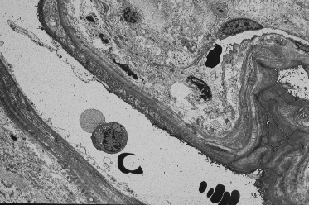
.
Notes:
As an illustration, Here is a p/t cap where the endoth bm is throw into more than 7 layers
xxxxxxxxxxxxxxxxxxxxxxxxxxxxxxxxxxxxxxxxxxxxxx
May type in text box: 7 or more layers in one cortical PTC and 5 or more layers in two additional capillaries
xxxxxxxxxxxxxxxxxxxxxxxxxxxxxx
Banff 2013 says >=7 layers in one cortical peritubular capillary AND >= 5 in two additional capillaries; avoid tangentially cut portions

Slide 44
Mean PTC ML >2.5 Layers Correlates TG in Patients with De Novo DSA
54 patients with dnDSA at 1 year
Mean PTCML count was based on 25 PTCs
AUC for separating TG from No TG=0.72
Comparable to MVI score >2 (0.74)
Better than corresponding AUC-C4d (0.62)
Measuring 25 PTCs at EM is tedious.
Showing ≥3 PTCs ≥5 layers was equivalent
Notes:
An example of the clinical value of assessing PTCML is seen in this study:
It showed that PTCML exceeding 2.5 layers correlated with TG in Patients with De Novo DSA
This was a study of 54 patients with denovo DSA detected 1 year post-transplant
Mean PTCML count was based on examination of 25 peritubular capillaries
The area under the curve for separating patients with and without tg (using this criterion) was 0.72
This AUC is comparable to that achievable by light microscopic microvascular injury score greater than 2
It is actually better than the corresponding AUC for C4d which was 0.62
MEASURING 25 peritubular capillaries at electron microscopy at EM is tedious, but
Showing presence of ≥3 PTCs ≥5 layers equivalent to calculating a mean PTCML>2.5
---
Xxxxxxxxxxxxxx
Mean of 10 was also as good as mean of 25
Xxxxxx
Counting 10 peritubular capillaries instead of 25 was almost as effective

Slide 45
PTCML is Not Specific for CABMR
Immune complex GN, SLE
Obstructive uropathy, Radiation
Analgesic nephropathy, Diabetic kidney
NOT common in grafts, PTCML not severe
- infrequent causes are prone to be overlooked
TCMR (eg Bx with PTCi but –ve C4d/DSA
Notes:
Other causes of ptcml are described in the literature.
--These include Immune complex GN, SLE
Obstructive uropathy, Radiation
Analgesic nephropathy, Diabetic kidney,
- These causes are ≠ common in grafts, PTCML in these conditions is not as severe, as it is in chronic ABMR
BUT THESE Low frequency lesions are prone to be overlooked when they are actually encountered
TCMR is not usually discussed as a cause of PTCML---but it should be in my opinion
Biopsies with peritubular capillaritis but –ve C4d and –ve DSA are not uncommon
These lesions have significant # of T-cells in them on immunohistochemistry,---and it stands to reason that persistent T-cell injury and bm repair HAS THE POTENTIAL to result in PTCML---when A DIAGNOSIS OF ABMR CANNOT BE ESTABLISHED

Slide 46
Case 3 = Presentation Subclinical/SMOLDERING C4d –ve Phenotype
.
Notes:
E p

Slide 47
Clinical History Case 3
Petite 37 yr F ESKD PCKD, Weight 45 Kg (99 lb)
High PRA, XRM –ve, No DSA pre-transplant
Discharged Day 7, Stable creatinine 1.3
Tac levels target range
Protocol biopsy at 3m
Notes:
This patient was a Petite 37 yr F, Weighting 45 Kg (99 lb)
She had a High PRA, but was XRM –ve, and there was No DSA pre-transplant
She was Discharged on Day 7, with a Stable creatinine 1.3
The Tac levels were in target range
A Protocol biopsy was perfomed at 3m

Slide 48
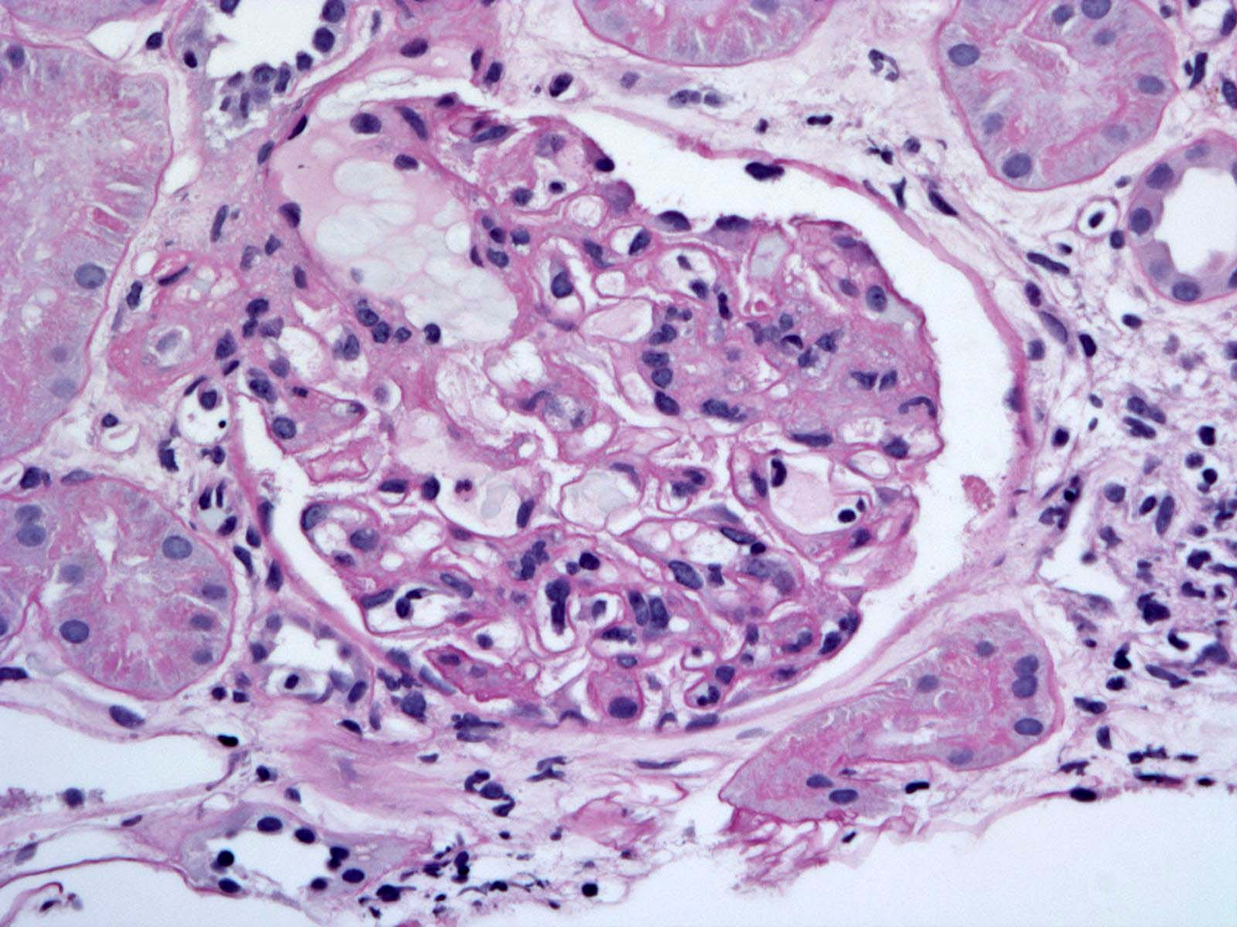
.
G2; Ti, i, t, v, ptc= 0 cg0, ci0, ct0, cv0
C4d = negative on FFPE
DSA: MFI 8000
Best Diagnosis: Subclinical C4d negative ABMR
(IF, EM desirable)
Notes:
THE MOST STRIKING CHANGE IN THE BIOPSY WAS GLOMERULITIS.
The glomerulitis score was 2, ---total inflammation, I, t, v, ptc scores were all Zero3
The chronicity scores, ----cg, ci, ct and cv scores were also zero
A C4D stain was negative on FFPE
DSA was positive with an MFI of 8000
The best diagnosis is subclinical c4d negative ABMR (though strictly em is needed to r/o other diseases such as membranoproliferative glomerulonephritis and thrombotic microangiopathy (though unlikely given the cause of eskd was pckd
xxxxxxxxxxxxxxxxxxxxxxxxxxxxxxxxxxx
I WILL NOW PRESENT SOME BIOPSIES WITH MVI, ------without the C4d and DSA criteria for ABMR------Being Clearly Fulfilled.----------THESE ARE HYPOTHETICAL CONSTRUCTS meant to engender discussion---about how these cases should be managed--------Here is a Biopsy at 1yr, ---performed for rising creatinine of 4.0, ---
-----------Frozen tissue C4d showed a cluster of 5 +ve capillaries --but the % area affected was <10%, ---which is technically negative-------A DSA was found with an MFI of 500, ----which is below our diagnostic cut off of 1000-----------Angiotensin II-- type 1 receptor antibody was tested and found to be negative.
THE PHOTOMICROGRAPH SHOWS THAT THE MOST STRIKING CHANGE IN THE BIOPSY WAS GLOMERULITIS.
The glomerulitis, ---total inflammation, -- i and t scores were all 3, -----The v score was zero, -------the ptc score was 2
As for the chronicity scores, ----cg, ci, ct and cv scores were all zero
OPINIONS ON WHAT THIS CASE REPRESENTS ARE WELCOME-----YOU CAN USE THE CHAT BOX----
BUT MY OPINION IS THAT THIS BIOPSY IS ESSENTIALLY an ACUTE OR ACTIVE ABMR
By way of explanation---C4d staining can be very focal---and as long as a definite positive cluster is present-----insisting on the PURELY ARBITRARY threshold of 10% for frozen tissue----does not sound logical to me
Similarly the low MFI for the DSA ---may in fact reflect adsorption of the antibody to -----areas of the graft that were not sampled well by the biopsy-----------A VARIATION OF THIS CASE COULD BE CREATED WITH A NEW G2 FIGURE: g2, DSA 5000, c4d on fs IS CLUSTER BUT <10%-------2013 ABMR criteria BASED ON PROGNOSTIC CONSIDERATIONS ALONE. Banff Consensus is not implying mechanistic correctness
In my opinion molecular diagnostics detection of ENDATs or NK cell transcripts would not change the interpretation. It would be quite compatible with T-cells causing the lesion in a small proportion of biopsies
(yes isol glomerulitis like this is rare, but T-cells in ABMR are common)
and DSA tests negative both before and after the biopsy; MICA and Angiotensin II type 1 receptor antibodies (A-ii-T1R)
xxxxxxxxxxxxxxxxxxxxxxxxxxxxxxxx

Slide 49

.
G2; Ti, i, t, v, ptc= 0 cg0, ci0, ct0, cv0
FFPE C4d1: single cluster of positive PTCs
DSA: negative
Diagnosis: Subclinical C4d + DSA negative ABMR
Notes:
Here is another similar case with a slight twist
Banff scores were the same as in the last biopsy
.
FFPE biopsy was scored as C4d1: due to the presence of a single cluster of positive PTCs
DSA: negative
Diagnosis: Subclinical C4d + DSA negative ABMR

Slide 50
C4d- DSA- ABMR
1/10th – 2/3rds of DSA+ bxs with g, ptc, cg lesions
Inflated incidence older studies: discounted C4d1,2
C4d -ve < LOD or biopsy with ptc loss
Ab can directly affect endothelial function
If DSA false -: must also consider nHLA antibody or other endoth injury (TCMR, MPGN, TMP)
Notes:
These biopsies offer the opportunity of discussing the entity of C4d negative & DSA negative ABMR:
1/10th – 2/3rds of bxs with positive DSA, g, ptc, cg lesions from DSA are negative for C4d
The higher range I am quoting PARTLY reflects--An Inflated incidence reported in older studies which discounted by C4d1+ & 2+ staining can classified them as c4d negative (but chronic active ABMR series are also liable to be c4d negative)
In thinking about these cases, one consideration is that C4d may be negative because it is below the limit of detection –or--- that we have a biopsy with extensive loss of peritubular capillaries eg due to severe injury
Ab can directly affect endothelial function without activating complement
If DSA false positive: must also consider nHLA antibody or other endoth injury (TCMR, MPGN, TMP)
Xxxxxxxxxxxxxxxxxxxxxxxxxxxxxxxxxxxxxxxxxxxxxxxxxxxxxxxxxxxxxxxxxxxxxxxxxxxxxxxxxxxxxxxxxx
DSA +ve ENDATs + may reflect NK cell-cell/ADCC mechanisms which are C4d independent (3rd mechanism is direct action antibody on endothelium)
But we must also consider other forms of endothelial injury & incidental DSA
DSA – bxs more likely to be TCMR or nonHLA antibody mediated injury
It is worthe pointing out that some author report an inflated incidence by ignoring minimal/focal +vity & discounting alternate explanations (eg technical factors and kinetic issues vide infra)
Xxxxxxxxxxxx
DSA negative can be DP/DQ not tested,rare HLA antibody, non HLA ab
-DSA + ENDOTHELIUM ASSOCIATED TRANSCRIPTS
-But we should also consider other endothelial injury & incidental DSA

Slide 51
Antibody Independent Mechanisms of C4d –ve, DSA –ve, MVI
Non-HLA antibody: probably small %
NK cells: AICC, recognition of missing self
T-cells as a cause of MVI: a blind spot
Role of B-cell series: Plasma cell rich rejection.
Macrophage (Innate Immune System)CD47 –Mac Axis
which recognizes:
--A-type paired Ig-like receptors (PIR-As)
-- Signal regulatory protein alpha (SIRP-alpha)
-- Don’t Eat Me signal
Notes:
Adcc
In recent years basic scientists have uncovered several Antibody Independent Mechanisms of C4d –ve, DSA –ve, MICROVASCULAR INFLAMMATION. These are listed here.
Non-HLA antibody: account for only a small % of cases, ----that is my personal opinion
NK cells seem to have an imp role based on transcriptomics studies. --- AICC Antibody indep (or dependent) cytotoxicity, and recognition of missing self are the two different pathways that have been implicated (ADCC not for current discussion)
T-cells as a cause of MVI seem to be a blind spot for many people in the field: these cells constitute 30% or more of all inflammatory cells in these bxs, and they are very likely capable of directly causing endothelial injury .
Role of the B-cell series is brought out by biopsies that show Plasma cell rich rejection—ONLY A THIRD OR SO OF WHICH ARE C4 AND DSA POSITIVE .
Macrophages are a part of the (Innate Immune System), on pathway of particular relevance to their role in causing graft injury---is the CD47 –Mac Axis
which recognizes:
--A-type paired Ig-like receptors (PIR-As)
-- Signal regulatory protein alpha (SIRP-alpha)
The potential role of these pathways in tissue injury is being investigated by my colleague in Pittsburgh.
These receptor ligand interactions generate a so-called DON’T EAT ME SIGNAL. Inhibtion of this signal in patients with some genetic polymorphisms may initiate injury to the microvasulature
Xxxxxxxxxxxxxxxxxxxxxxxxxxxxxxx
ADCC strictly does not belong to this slide on antibody indep mechanisms of injury, but I think nk cells can cause ctx even without antibody involvement (CD8 cells express some of the same transcripts that NK cells do)
.
EVEN THOUGH WE CONSIDERED THIS CASE TO BE TCMR FOR THERAPEUTIC PURPOSES----
THERE IS A WIDER LIST of conditions to keep in mind in ----the d/d of---- c4d negative,--- DSA negative ---MICROVASCULAR INFLAMMATION
This includes
Non-hla ab; that is probably a small %age
Plasma cell rich rejection
AND----NK cell recognition of missing self
One must also remember Participation of ---Innate Immune System ELEMENTS--- such as THE CD47-Macrophage AXIS ---which can recognize at least 2 different types of molecules, NAMELY
---A type paired Ig like receptors (the so-called PIR-As)---and a protein called Signal regulatory protein α (SIRPα)
Basic scientists find that ---CD47 is a broadly expressed transmembrane protein---- that generates the so called "don´t eat me" signal.
In the presence of appropriate HLA Polymorphisms, this signal can be inhibited, resulting in graft damage
Xxxxxxxxxxxxxxxxxxxxxxxxxxxxxxxxxxxxxxxxxxxxxxxxx
Halloran’s defense of how DSA negative ABMR has the same profile and his other arguments are worth presenting one day. Halloran ajt 2022 in press: mdx of ABMR with or without DSA
a key determinant of the innate immune response to allogeneic non-self is donor polymorphism in the immunoglobulin superfamily (IgSF) membrane protein SIRPα that is sensed by CD47 on recipient monocytes.
Signal regulatory protein α (SIRPα) is a regulatory membrane glycoprotein from SIRP family expressed mainly by myeloid cells and also by stem cells^{[citation needed]} or neurons.
SIRPα acts as inhibitory receptor and interacts with a broadly expressed transmembrane protein CD47 also called the "don´t eat me" signal.

Slide 52
C4d + DSA – Biopsies
Issues of disease kinetics:
- adsorption DSA to graft
Presence of non-HLA antibodies (AECA, MICA)
Presence of Non-ABO antibodies in ABO-I Txn
ABO-I grafts in a state of accommodation
Complement med endothelial injury not requiring DSA
Notes:
AS A COMPARISON WITH THE C4D NEGATIVE DSA NEGATIVE BIOPSIES THAT I HAVE JUST TALKED ABOUT, let us now discuss C4d + DSA –ve BXS
These can be Issues of disease kinetics: eg
(a)adsorption DSA to graft
(b) AMR in the latent phase (C4d below LOD)
(c)Late chronic phase (capillary loss, scarring)
We can have the Presence of non-HLA antibodies (AECA, MICA)
We can have Presence of Non-ABO antibodies in ABO-I Txn
ABO-I grafts can be in a state of accommodation
Finally we can have Complement mediated endothelial injury not requiring DSA (to be discussed in the next slide)
xxxxxxxxxxxxxxxxxxxxxxxxxxx
(we are talking of C4d+DSA- biopsies with histologic changes (not the C4d category with no histologic evidence of acute cellular rejection)
Xxxxxxxxxxxxxxxxxxxxxxxxxxxxxxxxxxxxx
Looks like a contrived rason: Non-donor specific cross reactive HLA antibody getting reported as No DSA
Stable ABOI transplants, considered by some investigators to be examples of accommodation---------------- but this is not a term we should be using in our pathology reports. It generates a false sense of security; we should continue to monitor these patients for development of anti-HLA antibodies, transplant glomerulopathy and graft arteriosclerosis (most aboi patients with be HLA incompatible too)

Slide 53
DSA Independent Complement Mediated Injury
Lupus nephritis (granular, ICDs in PTCs)
Recurrent IgAN 16/66 = 24%(no DSA tested)
2/8 Bx ATI (no DSA tested, but ischemia accepted cause of C-activation (lectin & alternate) NDT 2008: 23: 1735
Recurrent antiGBM (n=2 cases reported)
Notes:
The conditions associated with complement injury independent of DSA are listed here The conditions other than amr that can cause focal or diffuse C4d in grafts) are
Lupus nephritis can cause C4d in peritubular capillaries; staining in these cases is coarsely granular, and electron microscopy actually shows immune complex deposits WITHIN peritubular capillaries
In post-transplant igan, one chinese study records ptcC4D in 16/66 = 24%, but donor specific antibodies were not measured, so that we cannot rule out incidental RECURRENT IgA WITH TRUE true AMR (do not remember focal or diffuse stated)
One study found C4D+ 2/8 biopsies with ATI (dunno if focal) in india; no dsa tested; but ischemia is an accepted cause of complement activation, although most investigators find this to be so for the Lectin and alternate—and not the classical ---pathway
overall incidence c4d in all of their routing paraffin biopsies was 45%; PTC dilation itself said to be a feature (without discussion of inflamed nature) Ranjan, Joshi: NDT 2008 23 1735
Recurrent antiGBM disease is another possibility and at least 2 cases are reported. The ptc staining here likely reflects production of antibodies directed against some endothelial antigen
Xxxxxxxxxxxxxx
I have seen one case with diffuse C4d staining in the peritubular capillaries (with diffuse linear staining also seen in the GBM & focal granular or linear staining in the TBM) ( TBMgranularC3 but linear IgA); ----?Dr Nickeleit makes a reference to another such case in one of his book chapters (Ruix—Nickeleit, do not state focal or diffuse) Batal antiGBM; Glomerular and tubular basement membranes staining easy to explain as alpha 3 chain of type IV collagen is present there; peritubular capillary staining requires postulation of antibodies to alternate minor epitopes present in some studies in up to 80% of cases (tubular basement membranes staining varies from uncommon to 80%);
Infection and ischemia are atn seem to be associated with c4d in some biopsies; and personally I believe at least some cases may represent true activation of the complement acting pathway by an infectious or ischemia associated antigen, but the concept is hard to prove in routine clinical practice, as we can never exclude the causes of apparent DSA negativity I have just listed.
---Dr Feucht from Germany, who IS THE FATHER OF THE C4d SAGA; HAS A a paper in KI from 2001 in which he descibes ptcC4D in 11/19 atn, & 6 of 10 RECURRENT OR DENOVO glomerulonephritis (but does not mention if it was focal or diffuse, and presents no data on donor specific antibodies).
---Subsequently, in a REVIEW ARTICLE article from 2003, he EXPRESSES WHAT IS NOW THE MAINSTREAM OPINION THAT acute tubular necrosis DOES NOT cause C4d deposition in the kid, BUT ACKNOWLEDGES THAT ACUTE TUBULAR NECROSIS can result in c3 and c3d deposition (C4 NO, C3 YES)
---Xxxxxxxxxx
ATN even in mice activated alternate pathway (C3+, C4d-); kid int 2005; 67: 524; however heart and intestine yes classic pathway gets activated in ischemia
ANCA activate only alternate pathway and will not explain C4d (but could explain low complement levels in serum)

Slide 54
TECHNICAL CONSIDERATIONS: C4d-ve ABMR
Technical problems with C4d staining
- formalin fixation
- tissue preservation
Technical problems with Ab testing:
False +ve due to a cross reactivity with
-related ag
- irrelevant denatured antigen
Notes:
I want to touch upon some Technical Considerations that are relevant to the interpretation of C4d staining and DSA testing
For C4d-ve ABMR
We must consider; Technical problems with C4d staining such as
-formalin fixation, tissue preservation, focal staining in small piece
And we must also look into Technical problems with Ab testing
Eg a (false +) possibly a cross reactivity
to related single ag beads
or irrelevant denatured antigens
xxxxxxxxxxxxxxxxxxxx
Disease kinetics:
-AMR is in latent phase (C4d below LOD)
-Late chronic phase (capillary loss, scarring)
Some C4d negative biopsies just reflect Disease kinetics:
-AMR is in latent phase (C4d below LOD)
-Late chronic phase (capillary loss, scarring)
Below LOD meaning limit of detection
In day today practice C4d and DSA do not always go hand in hand: you will periodically encounter cases that are DSA+ but c4d negative; this may be due to
The AMR may be in a latent phase (which might be the a prelude to clinical amr, the PROVERBIAL LULL BEFORE THE STORM)
It could be in the regulatory phase (esp ABOI) due to the presence of °C inhibitors or anti-idiotypic antibodies (in such patients donor specific antibodies can persist for months or even years without apparent harm)
We may also be dealing with the late chronic phase characterized by tissue damage and capillary loss: IN OTHER WORDS WE CANNOT DEMONSTRATE C4d IN PERITUBULAR CAPILLARIES SIMPLY BECAUSE THERE ARE NOT MANY CAPILLARIES REMAINING IN THE TISSUE WE ARE EXAMINING ----(presumably atrophic and minimally functioning tubules) (note also that with extensive tissue damage we can get which lead to actin or HLA antibody production as a SECONDARY phenomenon)
Donor specific antibodies+C4d negative category: Woodle’s group: Everly et al 2009 AJT 9 1063 show that if p/c is ac rej (52) and dsa is de novo (16), 4yr graft survival is lower 65% vs 100% compared to no dsa (vs 35% if c4d also +)(6.6 fold risk graft loss)
The presence of necrotic or scarred areas can also give a non-specific reaction ----vide ruiz/nickeleit (in addition to a false negative reading; Xxxxxxxx
Latent phase AMR (no binding or insufficient binding/titer at this time or non-complementary binding)
Irrelevant antibodies (?DP/DQ) not well expressed by endothelium
Regulatory mechanisms (anti-idiotypic, complement inhibitors)
False+DSAtest: ATG/OKT3 should not bind Luminex beads/ELISA plates coated with MHC, but in some systems mouse anti-human antibody could bind the secondary antibody in Luminex/ELISA system-→ increased MFI and false positive reaction

Slide 55
Technical problems: Reverse Scenario: C4d + DSA –ve Biopsies
Technical problems with C4d staining
-high background, necrotic or scarred area
Technical problems with antibody testing
(a) Date of testing not matching biopsy date
(b) Rare antigen not present in testing panel
(c) Incorrect HLA Typing of donor HLA
(d) Incomplete typing (A02 to 2 digits, DP, DQ not tested)
.
Notes:
Let us now consider technical problems causing the reverse scenario, namely, C4d positive but DSA negative biopsies ;
These can be Technical problems with C4d staining such as
-high background, necrotic or scarred area
We can also have Technical problems with antibody testing eg
(a) Date of testing not matching biopsy date
(b) Rare antigen not present in testing panel
(c) Incorrect HLA Typing of donor HLA
(d) Incomplete typing (A02 typed to 2 digits, DP, DQ not tested)
xxxxxx
--The date of a purportedly negative test for donor specific antibodies may not match the biopsy date (sometimes it precedes the date of the biopsy by a week or more and in this case testing should be repeated)
-You may be dealing with a rare HLA antigen not actually present in the testing panel (antigen actually present in the donor may not be have been tested for directly (false negative call)
(simply because antigen was not present in the ELISA pra panel used)
--An incorrect HLA typing of the donor should be kept in mind
--Another possibility is incomplete DONOR HLA typing such as missing DP or DQ genotypes or phenotypes (for example we periodically encounter cases transplanted in the 90s who were only typed for A, B and DR antigens. RECIPIENT Serum taken at the time of a MORE RECENT biopsy with focal C4d might CONTAIN an anti-DP or DQ antibody and there is no way of determining if this is donors specific or not.
XxxxxxxxSome biopsies have a very high background; and the presence of necrotic or scarred areas can also give a non-specific reaction ----vide ruiz/nickeleit (in addition to a false negative reading; 6 AG match; focal c4d; is certainly possible (ab to non ABDR); Focal c4d; elisa screen neg can be ab to unusual ag not represented on beads used for ab screening; ie ELISA screen can be neg and yet dsa be positive
Note ABO antigens are expressed on wbc, platelets, some epithelium, some endothelia: these should elicit reaction in white CELL- based cross matches); BUT we will not detect such antibodies if you use purified antigens in ELISA and luminex?
Unusual DP, DQ not in panel could be missed I guess? Review lunz antigen tray literature
MICA = MHC class I Chain related protein A (or B)
GRAFT ABSORPTION: Bocrie et al. Transplant Immunology 2007; 17; 227: 12 patients graft nephrectomy: antibodies could be eluted from graft in 58% but blood only 17%
Xxxxxxxx
With sensitive flow techs 42% of HEALTHY subjects have class I hla ab; 11% class II, 12% both; this must be cross sensitz to natural ags in env; fortunately these abs react to only the infrequent HLA ags eg A31 B76 B82 in class I and DPA1*02 DPB1*01 etc in class II (Txn 2008; 86 1111)
Xxxxx
From time to time we see a phenomenon that is the reverse of what is just described, namely, C4d positive but DSA negative ;
--

Slide 56
Anti-HLA AB WITHOUT Donor Specificity
Statistically more AR & worse outcome
Marker for high immune responsiveness
DSA present below LOD,
-subject to competitive inhibition in the assay, - be directed against a rare antigen, as noted
Monitor carefully for ab titer and RFT
Hourmant et al. JASN2005;16;2804
Notes:
There is one other ---Not uncommon scenario that I want to cover-----viz that laboratory work up reveals ANTI-HLA Antibodies that are NOT DONOR SPECIFIC
-Even though CRITERIA FOR AMR ARE NOT COMPLETELY FULFILLED in this situation, it HAS BEEN shown that such antibodies are STATISTICALLY ASSOCIATED with more AR and worse outcome
This is probably because these antibodies are a marker for high immune responsiveness.
It is possible that donor specific antibodies is present below LOD= limit of detection or subect to -----or directed against an antigen not represented on the beads) as I noted earlier
Hence, these cases should be monitored carefully
xxxxxxxxxxxxxxxx
DSA present below LOD,
-subject to competitive inhibition in the assay, - be directed against a rare antigen, as noted or
- an allele that was not typed eg HLA-A0203
In the case of rare HLA antigens it is possible that an antigen actually present in the donor may not have been tested for directly (not represented in the panel used), but antibodies to a cross reactive antigen may in fact be present

Slide 57
Case 4 Presentation Chronic INACTIVE Phenotype
.
Notes:
My second case is a follow up of biopsy from the first patient after an interval of 6 months

Slide 58
Clinical History Case 4
62 yr M
Transplanted at outside hospital 3 yr ago
Indication biopsy for 3 g/day proteinuria
Notes:
Next I present a 62 year old man
Transplanted at an outside hospital 3 yrs ago
An indication biopsy was done for 3g/day proteinuria

Slide 59
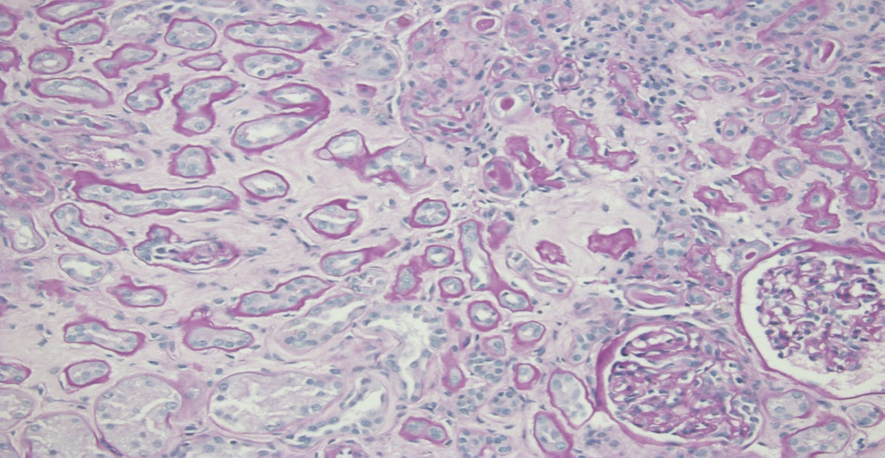
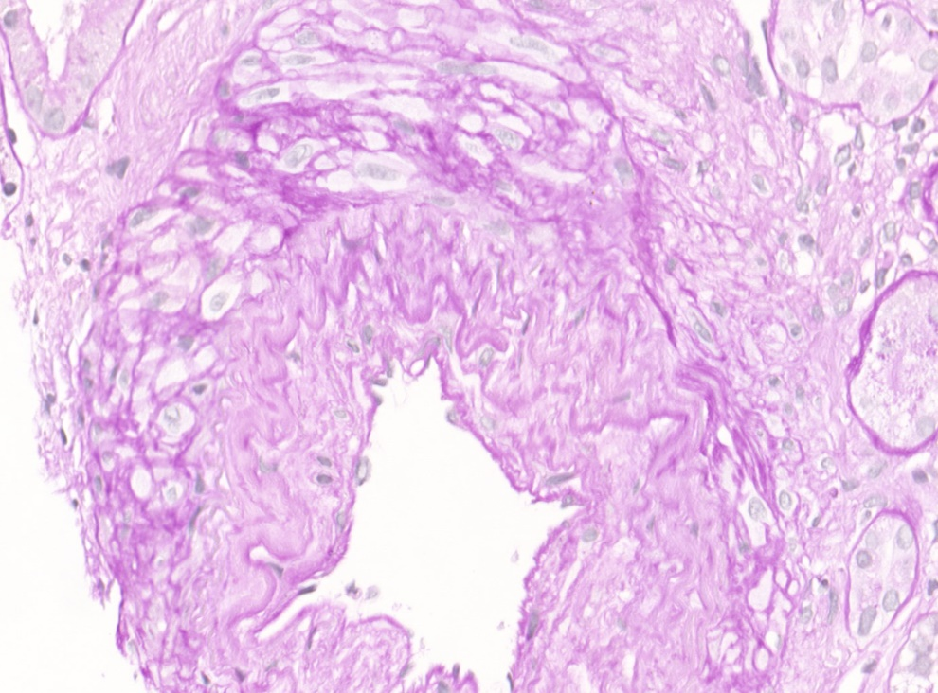


Case #4
C4d –ve, DSA +ve MFI 1200 Chronic INACTIVE ABMR& ATI
Notes:
Biopsy had LG inflammation and tubulitis in areas with fibrosis; Did not meet the criteria for BL change or acute TCMR
Arteries showed mod to severe arteriosclerosis: this was presumed be new onset since the donor was a healthy 30 year old son
Jones stain showed chronic transplant glomerulopathy as illustrated by this extensive double contouring of the gbms
Em confirmed subendothelial translucent material, and mesangial interposition, with no immune complex deposits that ruled out glomerulonephritis.
C4d stain was negative in the ptcs. DSA was detected with an MFI of 1200 which was barely above reporting limit, but likely the residuum of a a higher titer in the past
The best fit diagnosis here is chronic INACTIVE abmr
xxxxxxxxxxxxxxxxxxxxxxxxxxxxxx
The biopsy showed some ATI, was C4d negative and DSA negative.
However, he had suffered a C4d POSITIVE, DSA POSITIVE ABMR in year 2
Hence this biopsy was assigned a diagnosis of chronic INACTIVE ABMR
(and acute tubular injury to explain the rise in serum creatinine)
xxxxxxxxxxxxxxxxxxxxxxxxxxxxxxxxxxxx
Make a note of waste basket No Rejection Category : includes molecular ABMR

Slide 60
Dx Criteria Chr. INACTIVE ABMR (Banff 2019)
MV lesions of chr injury (cg, new onset AS, PTCML)
NO evidence recent/concurrent Ab interaction with vasc endothelium (g0, ptc0, C4d -)
AND
Serologic evidence of REMOTE DSAs
OR
Active ABMR documented in a prior biopsy
Notes:
For didactive purposes: The diagnosis criteria of Chronic INACTIVE ABMR according to Banff 2019 are:
MV lesions of chr injury, namely, cg, new onset arteriosclerosis, and PTCML
NO evidence recent/concurrent Ab interaction with vascular endothelium
This implies Banff scores of g0, ptc0, and C4d 0
AND
. Serologic evidence of REMOTE DSAs (or an active ABMR documented in prior biopsy)
xxxxxxxxxxxxxxxxxxxxx
Calling inac
NO DSA is indeterminate may be past ABMR or TCMR or mixed

Slide 61
New Onset Arterial Intimal Fibrosis
New onset: not seen in an earlier pre/post TxBx
Exclusion of other causes AS is imp (D, HT,V1)
Intima of affected arteries is sclerotic
Leucocytes within sclerotic intima not require
- favor chronic ABMR if they are present
provided no prior history of TCMR (present also in chr TCMR)
Notes:
Of the 3 lesions of chronic tissue injury, the only one I have not discussed so far is
New Onset Arterial Intimal Fibrosis
The qualifier New onset in this terminology: means that this lesion should not have been seen in an earlier pre/post TxBx BEFORE the diagnosis of abmr
Exclusion of other causes AS is imp: examples include donor arteriosclerosis, recipient hypertension and healed intimal arteritis or anca vasculitis
Intima of affected arteries is sclerotic, by definition
leucocytes within sclerotic intima are not required (Gary Hill)
(but) favor chronic ABMR if they are present
provided there is no prior history of TCMR (because leucocytes can also be seen in chronic TCMR)
xxxxxxxxxxxxxxxxxxxxxxxxxxxxxxxxxxxxxxxxxxxxxxxxxxx
NB: (Leukocytes within sclerotic intima may be present in chronic ABMR or chronic TCMR: footnote #10 in 2013 table)
Haas review Curr Opin Nephrol Hypertens 2018: 27: 137 Table1 notes that leucocytes are present but are not required for chronic ABMR (gary hill non-specific arteriosclerosis); I think the same rule needs implemented for chronic TCMR
xxxxxxxxxxxxxxxxxxxxxxxxxxxxxxx
Chronic active is the overall term though some are acute on chronic and need urgent treatment if mild chronicity
cg0 versus cg1 is also a subtle change; overall agreement in cg scores between 3 pathologists is 67% (specifically 0 versus 1 not available and likely to be even higher)(Smith et al, stegall, Transplant In 2018: 32 173)
Discrepancy has little clinical significance as no therapy is triggered by the call
xxxxxxxxxxxxxxxxxxxxxxxxxx
Clinical dysf is required by nih pane; others recognize subclinical acr

Slide 62
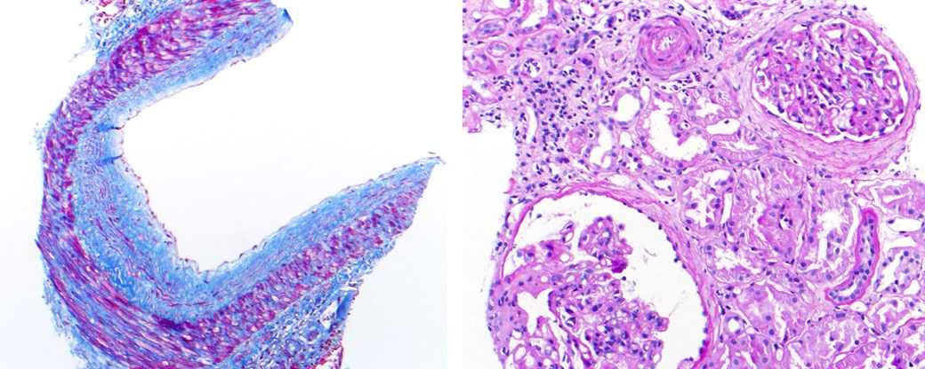
J Am Soc Nephrol. 2011 May;22(5)
May be indistinguishable from hypertensive CV
Notes:
This study by Gary Hill & alex loupy showed that DSAs accelerate arteriosclerosis after kidney transplantation
Such arteriosclerosis may be indistinguishable from hypertensive arteriosclerosis.
Left panel shows a patient with chronic inactive ABMR
Right panel shows arteriOLOsclerosis in a NATIVE kidney with hypertension, BUT A HEALED ABMR would look about the same

Slide 63
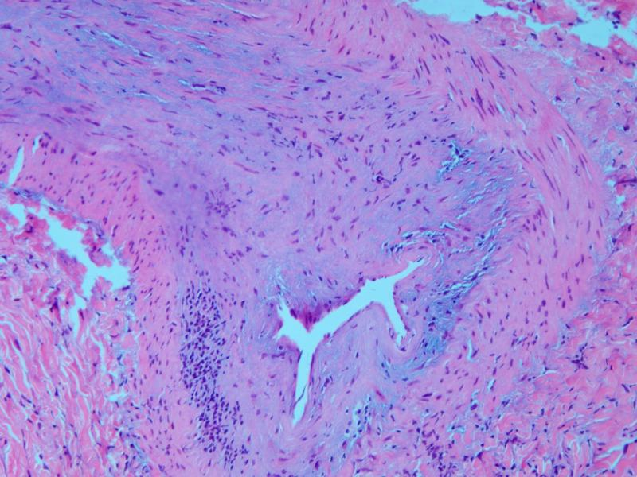
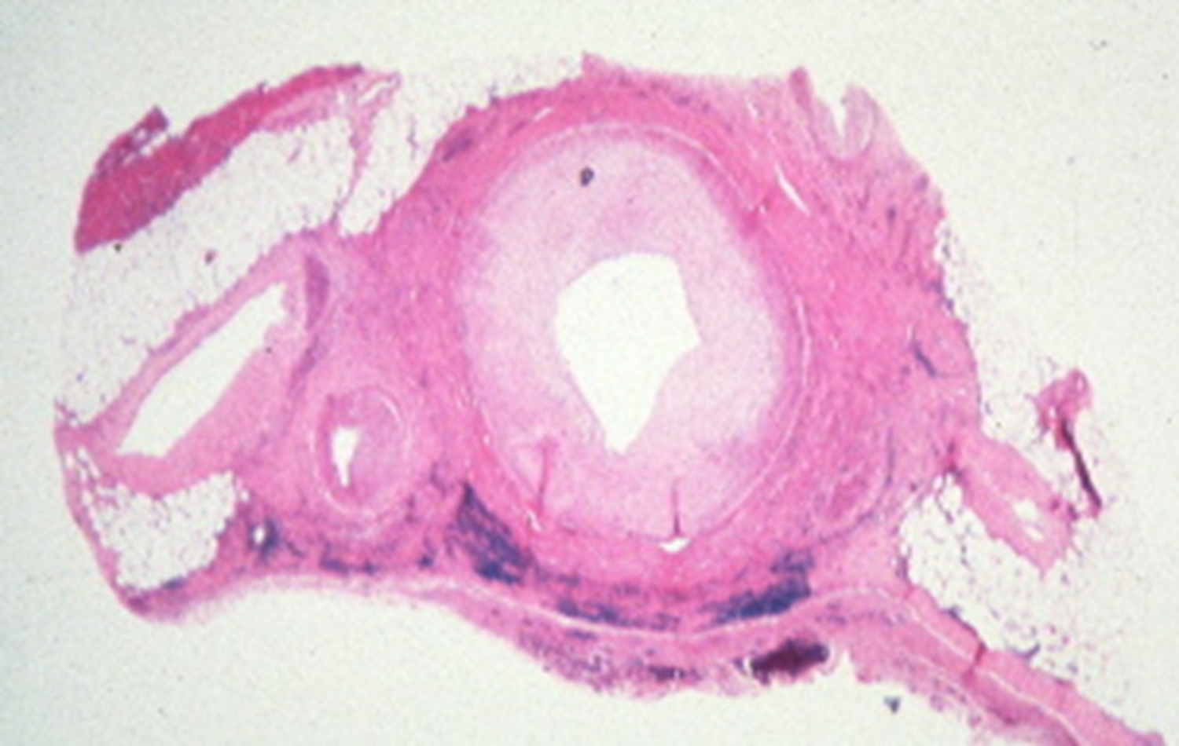
Chronic Active TCMR, Grade II
Bland CV
Notes:
More Examples of new onset in arteriosclerosis. These photomicrographs are from an allograft nephrectomy with chronic TCMR
Left panel show intimal fibrosis with inflammation and satisfies Banff 2019 criteria of chronic active TCMR
The middle panel is the same with more myxoid change
The right panel shows a bland form of arteriosclerosis: which is not officially recognized as chronic active TCMR---
However, in my experience, LATE BIOPSIES from patients with multiple episodes of acute TCMR typically show no intimal inflammation
A case could be made that such non-inflamed arteriosclerotic lesions be acceptable for a diagnosis of chronic inactive TCMR,--as is now the case for chronic ABMR. but this viewpoint is NOT YET acknowledged in the Banff Schema
Xxxxxxxxxxxxxxxxx
Banff 2018 guide; cv1 upto 13% reduction luminal radius; Cv2 29% reduction radius is 50% reduction area

Slide 64
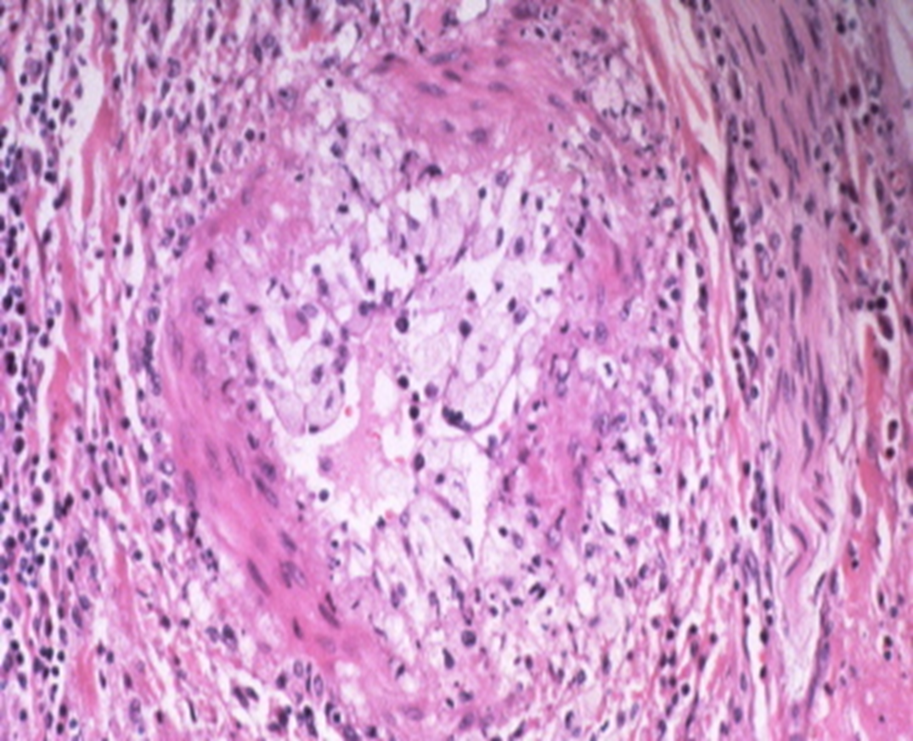
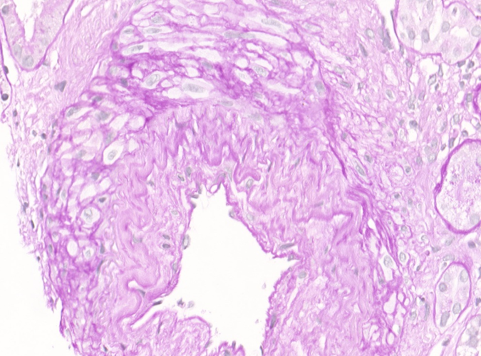
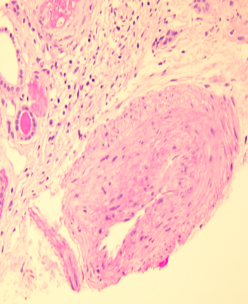
Notes:
Here are some other lesions of new onset arteriosclerosis that I have seen in the few past years.
The first panel shows foam cell arteriopathy in a patient with chronic ABMR
In the 2nd panel arteriosclerosis was a manifestation of donor derived arteriosclerosis and----
This 3rd panel represents the healed stage of vasculitis in a patient with ---recurrent ANCA associated glomerulonephritis—occurring within a transplanted kidney
Thus, Interpretation of biopsies with arteriosclerosis can bis problematic----when they are not accompanied by relevant info----about the medical h/o, biopsy findings the implantation biopsy,-------and the cause of ESKD that led to transplantation.
xxxxxxxxxxxxxxxxxxxxxxxxxxxxxxxxxxx
Gax affects vessels of all sizes; here we see inv of a larger interlobar artery running through the medulla; similar lesions may be seen in the main hilar arteries of the kidney

Slide 65
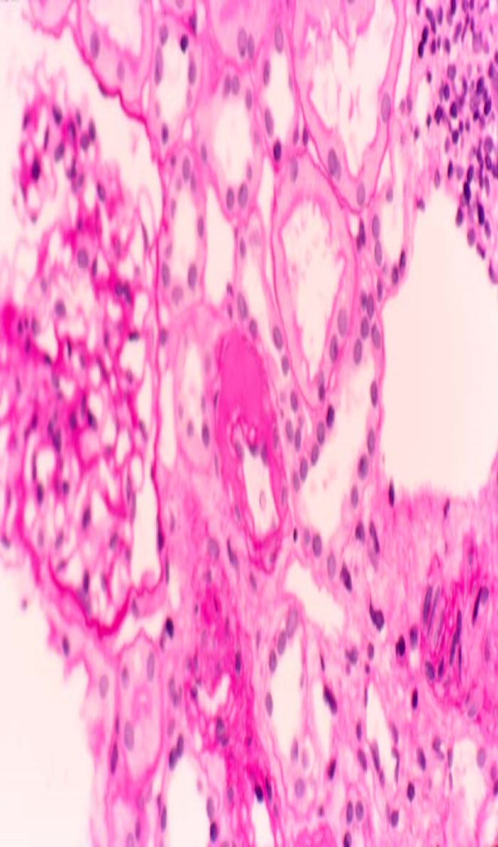

Arteriolar Hyalinosis: no continuous IEL, 1-3 layers
CNI toxicity
Hypertension
Diabetes mellitus
Donor disease
Ageing
HUS, PSS, radiation
ABMR
TCMR
Notes:
New onset Gax should not be confused with ah---a lesion that involves small arteries with no continuous elastic lamina, and a muscular layer no more than 1-3 layers of smooth muscle. ---as opposed to arteriosclerosis, which affects more proximal muscular and elastic arteries
Whereas NEW onset cv is considered to be diagnostic of chronic ABMR or chronic TCMR, ah should elicit a wider d/d that includes , a longer list of conditions, viz READ OFF THE LIST
ABMR & TCMR are not conventionally listed as cause of ah, but I HAVE SEEN THIS LESION APPEAR in follow up biopsies of patients with both ABMR and TCMR
Consistent with this interpretation, THIS VESSEL WITH AH—in the left panel--- LOOKS LIKE A MIRROR IMAGE OF THIS ARTERIOLE WITH TRANSMURAL INFLAMMATIONin the right lower panel.
xxxxxxxxxxxxxxxxxxxxxxxxxxxxxxxxxxxxxxxxxxxxxxxx
Rarely One final example of lesion non specificity is ah.
Detection of this finding led to over-diagnosis of cni tox in the allograft—in some very profile publications--- that appeared in respected journals---such as NEJM and AJT
It is imp to remember that this lesion can also occur in –
Hypertension
Diabetes mellitus
Donor disease
Ageing
HUS, PSS, radiation therapy for cancer.
---------------
xxxxxxxxxxxxxxxxxxxxxxxxxxxxxxxxxx
Detection of this finding led to over-diagnosis of cni tox in the allograft—in some very profile publications--- that appeared in respected journals---such as NEJM and AJT
Xxxxxxxxxxxxxxxxxxxx
(may shift 1 copy to ifta differential diagnosis)
Gax should not be confused with ah. In contrast to arteriosclerosis of muscular and elastic arteries, ah involves vessels with no continuous elastic lamina, and a muscular layer no more than 1-3 layers of smooth muscle.
Whereas NEW onset gax is considered to be diagnostic of chronic rejection, ah is a more ns lesion, which can be seen in a longer list of conditions, viz---
Usually
Rarely

Slide 66
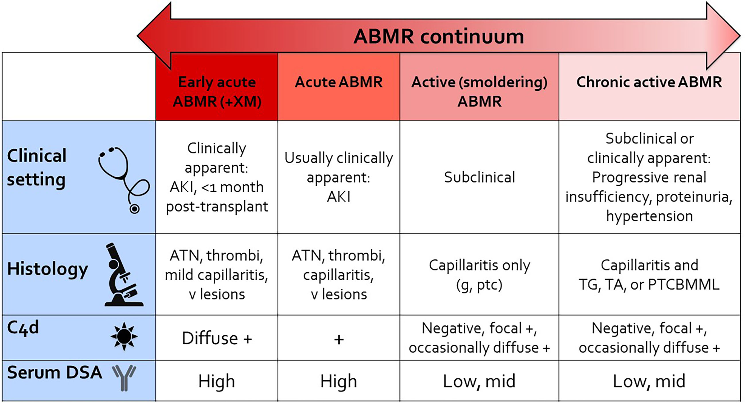
SUMMARY: CLINICAL SPECTRUM OF ABMR .
From Cornell LD. Histopathologic Features of Antibody Mediated Rejection:
The Banff Classification and Beyond. Front Immunol. 2021 Sep 27
Notes:
It is almost time to end my monologue, and engage you in a discussion, as to your experience with ABMR in India.
The cases that I have presented, fall into a spectrum that is illustrated in this paper by Lynn Cornell.
There is early ABMR due to pre-existing DSA.
And then we ABMR due to dn DSA that can present as Acute ABMR or as active smoldering ABMR.
Both can lead to chronic active ABMR.
These different phenotypes of ABMR can have a range of presentations that differ in the Clinical setting, Histology, C4d status, and presence of serum DSA.

Slide 67
Reporting The Spectrum of ABMR
Active/chronic active/inactive not sufficiently informative
Active can be g1 or g3
Chronic can be 1/50 capillary loops in a single glomerulus
Inactive can be ci0 or ci3
Dx Category must be read in context of Banff Scores
Bxs with the same Banff scores can differ markedly
Notes:
A couple of comments on Reporting The Spectrum of ABMR.
THE BROAD PHENOTYPES, viz, Active/chronic active/inactive not sufficiently informative for PERSONALIZED PATIENT MANAGMENT
Active ABMR can be g1 with glomerulitis in 5% of glomeruli affected or g3 with 100% of glomeruli clogged with intracapillary monocyte
Chronic active ABMR can be duplication of 1/50 capillary loops in a single glomerulus, with a normal urine protein creatinine ratio or extensive remodelling of the glomerular microvasculature with 12 gram proteinuria
Chronic INACTIVE ABMR can have no interstitial fibrosis or severe scarring
Dx Category must be read in context of Banff Scores
Indeed, even Bxs with the same Banff scores can differ markedly in the degree of damage: cv3 can mean 51% or 90% of the vascular lumen
It is highly desirable that treating physicians actually looks at the biopsies, while charting out a rx plan for their patient.
We do this during a biopsy conference every Monday, where all biopsies from the prior week are discussed jointly by the pathologist, the transplant nephrologist, the surgeon and representatives of the HLA lab.
The nursing coordinators and physician assistants are also present to implement any therapy decisions that are taken, eg arranging pulse steroids or getting insurance authorization for plasmapheresis.
.

Slide 68
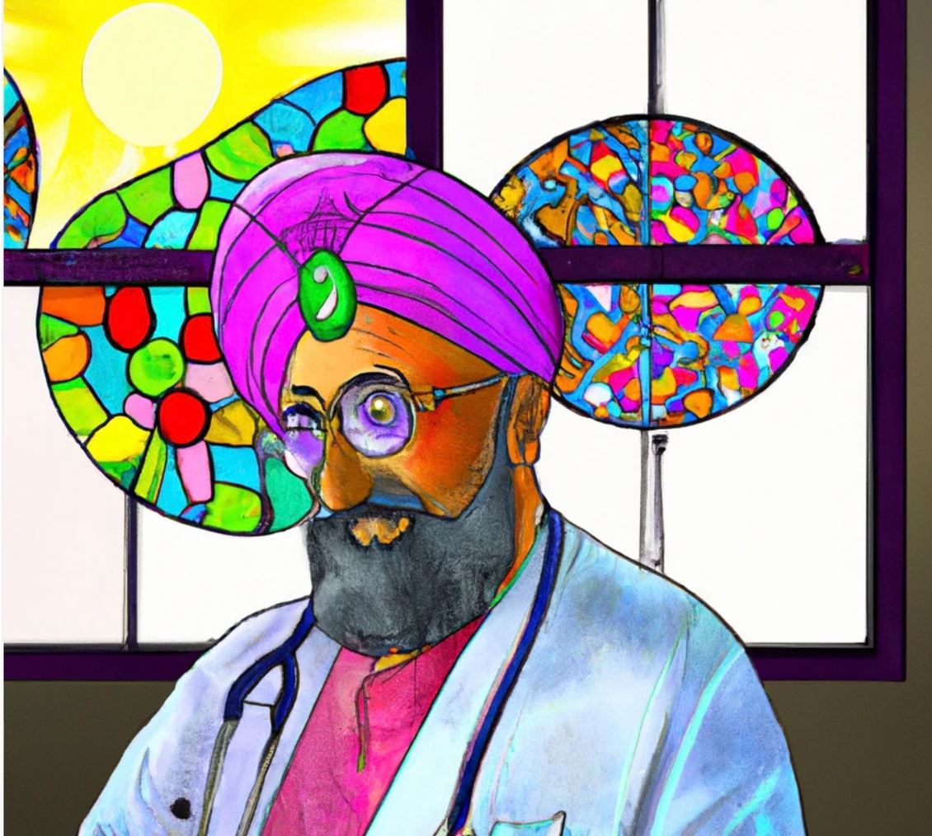

Notes:
That is the end of the sermon from the priest with a stethoscope that you have invited to your congregation.
This Artificial Intelligence conception of my personality was provided to me by kim solez; he typed my name into AI program called DALL-EE, and this is what came out.
I like the fact that it makes me look like a thoughtful person---and that it has something resembling EXTRA-TERRESTRIAL kidneys in the background
I must categorically state that-----I do not really like this bulging eyeball--- which gives the impression that I have exophathalmos----or an anxiety disorder.
Thank you.
xxxxxxxxxxxxxxxxxxxxxxxxxxxxxxxxxxxxxxxxxxxxxxxxxxxxxxxxxxxxxxxxxxxxxxxxxxxxxxx
BEFORE TAKING YOUR QUESTIONS--- I AM GOING TO ASK BEN ----TO ALLOW KIM TO SHARE HIS SCREEN WITH US
Dr Solez is GOING TO REVEAL SOMETHING THAT MIGHT REALLY ALARM YOU-----------HE HAS ACQUIRED THE ABILITY TO ----SIMPLY TYPE YOUR NAME INTO DALL-E--- AND DISCOVER THINGS ABOUT YOU---THAT YOU WOULD RATHER have kept SECRET
The skeletons you have in your cupboard ----are no longer secure.
xxxxxxxxxxxxxxxxxxxxxxxxxxxxxxxxxxxxxxxxxxxxxxxxxxxxxx
Scofflaw biopsies can be fun, and satisfying once you have put them together with the clinical picture, and fitted them into a most likely cause scenario
for the treating doctor
ALL-E (stylized as DALL·E) and DALL-E 2 are machine learning models developed by OpenAI to generate digital images from natural language descriptions,
called "prompts".
.

Slide 69
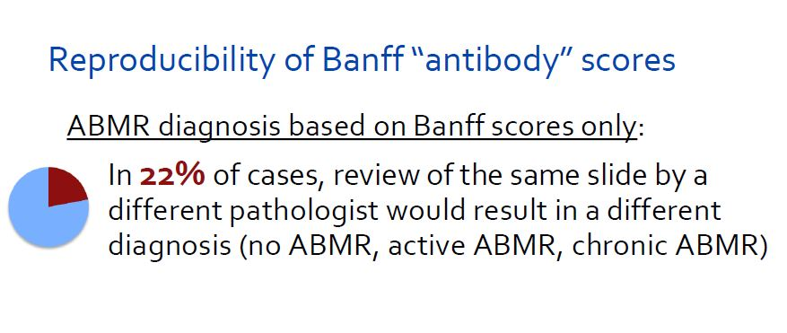
Addressing Reproducibility: 2 will agree on 45-67% for g and
peritubular capillary, 54-81% for cg
Lynn Cornell
Inter-observer agreement of individual MVI scores is also low as measured by conventional kappa scores—roughly in the 0.3 to 0.7 range.---varies with experience and training ---what this means is that rx decisions should not be based on reading just the overall diagnosis-----look at the scores---high scores like g2 and g3 given by a competent pathologist should be taken very seriously----for the lower scores come and look a the biopsy---get a feel for the overall structural integrity of the biopsy—correlate with graft function—evaluate the immunologic risk category of the patients– and then decide if any intervention is needed----when in doubt a wait and watch policy can be followed---

Slide 70

Lynn Cornell
Notes:
Lynn cornell

Slide 71
Subclinical ABMR
Incidence will depend on cohort: very low for us, 20% or higher if sensitized or xrm positive
C4d focal or negative; DSA variable in our cohort (would be very high in Mayo)
Yes, there is potential to progress (especially Mayo) but we have seen cases resolve in low risk patients (just as DSAs often resolve)
No standardized rx approach has been established
Optimization of I.S. reasonable.
scores come and look a the biopsy---get a feel for the severity as well as the overall extent—evaluate the immunologic risk category of the patients– and then decide if any intervention is needed----when in doubt a wait and watch policy can be followed- DSA titers can be non-iinvasive way to m onitor, albeit imperfect

Slide 72

Notes:
.

Slide 73

Notes:
I was feeling a little dopey while preparing for my talk last night; forgot to expand this stolen image and get it to fill up the entire surface area of this slide

Slide 74

Notes:
74
Having covered why it is necessary to screen for BKV, we can ask the question HOW can we go about doing so.

Slide 75


Early acute ABMR in patients with preformed DSA
Aggressive form of ABMR
If not recognized and treated quickly, it can lead to cortical necrosis and allograft loss within days
Schinstock CA, Mannon RB, Budde K, Chong AS, Haas M, Knechtle S, Lefaucheur C, Montgomery RA, Nickerson P, Tullius SG, Ahn C, Askar M, Crespo M, Chadban SJ, Feng S, Jordan SC, Man K, Mengel M, Morris RE, O'Doherty I, Ozdemir BH, Seron D, Tambur AR, Tanabe K, Taupin JL, O'Connell PJ. Recommended Treatment for Antibody-mediated Rejection After Kidney Transplantation: The 2019 Expert Consensus From the Transplantation Society Working Group. Transplantation. 2020 May;104(5):911-922

Slide 76

FINE TUNING CHRONIC ACTIVE TCMR (IT IS NOT ALL ABOUT ABMR)
Prof Parmjeet Randhawa, M.D.,
Division of Transplantation
Department of Pathology
University of Pittsburgh
Notes:
CONTACT VICTORIA RAMSAY AGAIN EARLY ON WED FOR POLLING
Thanks mark and alex for giving me an opportunity to presentation on a topic that I really feel very passionate about.
Normally the title slide for my talks has a picture of Pittsburgh in it. But I thought there was no sense in doing that since you have staying in the heart of downtown Pittsburgh for the past 3 days. So I show you this picture of a city called Benares in India. It has a river front just like Pittsburgh (Ganga). However, the downtown is definitely more antique, and the river water has holsitic properties which you can’t find anywhere in the USA
(transcend all the pollutants in it).
As we all know conquering i-IFTA is going to be the key to improve long term graft survival which has remained pretty much stuck, with only marginal improvements in the past 20 years
xxxxxxxxxxxxxxxxxxxxxxxxx
Right half of picture= downtown Pittsburgh AGHmonOhio= is on brochure sent out to all of you; right half of the Ganges in downtown benares india; Mentioned transplant from india; functioned reasonably well; and salt-pepper CAN; Tolerogenic protocol;

Slide 77

Banff 2019 Update on the Diagnosis of Antibody Meditated Rejection in the Renal Allograft
Parmjeet Randhawa
Division of Transplantation
Department of Pathology
University of Pittsburgh
Notes:
October 1st, 2019: 9:20 to :9:50 is 30 min talk; Primary source is the ATC premeeting ABMR talk which was for 30 mins and had 73 slides
PRELIMINARY PRACTICE SESSIONS SHOWED IST 30 SLIDES TO MDX WERE 15 MIN, chronic ABMR is 6 mins; AND MDX 12 SLIDES WERE 8 MINS
BANFF 2019: Use own notes or ask the FRIDAY SPEAKER TO SEND YOU A SUMMARY ON THURSDAY NIGHT
Candice editoral set of references important; When 95% ready and timed: you may bring in updated Halloran papers
Leave some room to expand: General Banff 2019 notes should be scanned for incorporation as you fly to india; also Thursday Moderation of all working groups, including antibody, and a special Thursday workshop Kidney II, 2:30 to 6:30 will likely generate more material for last minute inclusion or editing
Minor edits will likely be indicated in electron microscopy findings, and archetypes, and phenotypes (read your whole talk and make edits in different color to point out recent change)
Loupy clinical archeytpes likely to come in

Slide 78

Resurgence of Acute & Chronic Active TCMR as a Potential Player in Kidney Allograft Dysfunction:
Professor Parmjeet Randhawa, M.D.,
Division of Transplantation
Department of Pathology
University of Pittsburgh
Notes:
Day 2: Feb 16, Sunday, 9:50 am to 10:30 am = 40 mins (ASN Talk was 30 mins)
Dr. Halloran has very nicely outlined for us the clinical spectrum of ABMR. The task assigned to me is to show that T-cells also play an important part in mediating graft injury, sometimes with antibody, and IN OUR EXPERIENCE , MORE OFTEN on their own.

Slide 79
Suggested Case Spectrum in General
.
Classic acute/active ABMR (or one with DSA500 & FS cluster of c4d <10%)
Chronic ABMR: point our heterogeneity & need to look at scores
Mixed ca-TCMR-ABMR is imp: clinicians & MMDx® may just call it ABMR
V-lesions
BKVN-ABMR: include your BKV case by making it c4d positive and discussing your DSA literature from Basel
MVI- C4d positive(g0 &/or ptc0)
MVI- C4d negative, DSA positive(g0 &/or ptc0)
MVI- C4d negative, DSA negative (g0 &/or ptc0)
ATI- C4d positive= Ian Gibson
ATI – C4d negative, DSA negative: see GibsonEarlyMVI.PPT
Medullary C4d positive—see medullary pathology slide below
Suspicious for ABMR– as of 2013 & 2015? –what is it now (probably more than one category)
Subclinical acute/active ABMR (get the references, but first get the talk done)----subclinical isol V1 would be a variant
Notes:
.
.

Slide 80
Suggested sub-texts for cases to be presented
3m g0 ptc2 C4d becomes ABMR without mandate to check DSA
subclinical ptc with c4d, ----subclinical g and no c4d or DSA
Create a scenario wherein cg1b in 1 of 10 glomeruli making it chronic active ABMR –with potential for miscommunication
i1 t1 in 3m protocol biopsy- do not want to call the BL acute
Subclinical isol-v-----Ian Gibson peritubular capillaritis in ATN (Possibly with permission if not published)-------
Medulla with ptld, xanthogranulomatous pyelo, organizing thrombi
Notes:
Ati: Pathologic Acute vs Clinically Stable BL: Banff Acute Scores Can be Seen in Protocol Biopsies
Acute terminology, stable graft dramatic illustration of discordance between Banff acute and Clinical acute
May need quick review of subclinical ABMR

Slide 81
INTRA-GRAFT DSAs (reference stack available in manual reference files)
Technically demanding but has been done for both frozen needle biopsies (if generous) and nephrectomies
In general +ve test more likely to be associated with ABMR pathology (but 20-40% of serum DSAs have no concurrent rejection)
Could yield additional diagnoses ABMR when serum DSA negative; but improvement over Banff 2017 may be small if any! ----Sensitivity may not be good; ------Specificity may not be optimal either (TCMR could have serum +ve graft negative)-----Also a lot of work will be needed to establish diagnostic cut offs for intra-graft antibody titers; & cut offs will likely vary in different centers with different platforms and assay protocols
Conversely, serum positive and graft negative cases would not rule out ABMR if biopsy ABMR pathology is present; biopsy sampling error issue & also sensitivity issue (for patients undergoing indication biopsies one study found graft DSA in only 41% of those with serum DSA

Slide 82
Banff 2019 MVI Notes: section 3.4--- see notes section to review outcome of patients not having the antibody-c4d-DSA triad
Notes:
. At the Banff 2017 conference, updates to the ABMR classification were made to help with decision-making in cases where a biopsy showed at least moderate MVI ((g + ptc) >2) but no detectable antibodies against the graft.
However, there are considerable numbers of biopsies with (g + ptc) >2 in the absence of detectable anti-HLA DSAs or C4d, and with molecular ABMR testing not widely adopted at this point, the clinical implications of these findings remain unclear.
Recent evidence has suggested that patients with MVI on biopsies performed early posttransplant in the absence of DSAs had significantly better graft survival than those with anti-HLA DSAs (mainly low-level, preexisting DSAs), regardless of the presence or absence of PTC C4d staining on the biopsy.------DSA+ patients were more frequently retransplant recipients and had C4d+ biopsies.
By contrast, studies of patients biopsied much later with more severe MVI and frequent transplant glomerulopathy (TG) ----showed no difference in graft survival in the presence or absence of anti-HLA DSAs, which in these studies were de novo DSAs------
Thus, at this point, we are unable to draw significant conclusions regarding the significance of biopsies showing (g + ptc >2) in the absence of anti-HLA DSAs, other than to comment that the biological behavior of such changes may well differ depending on whether these are seen relatively early .
In addition, the differential diagnosis of MVI with negative DSA and negative C4d should include T cell–mediated endothelial injury (ptc), membranoproliferative glomerulonephritis (g), and thrombotic microangiopathy (g).
Furthermore, it has been shown recently in large populations that non-HLA antibodies could be independently associated with risk of allograft loss. .
It is also hoped that implementation of molecular diagnostics could help classifying these cases in a more pathogenesis-driven way, .------providing greater insight into factors predictive of the biological behavior of MVI without detectable anti-HLA DSAs, as well as cases with C4d staining without MVI.
..

